Slide 1
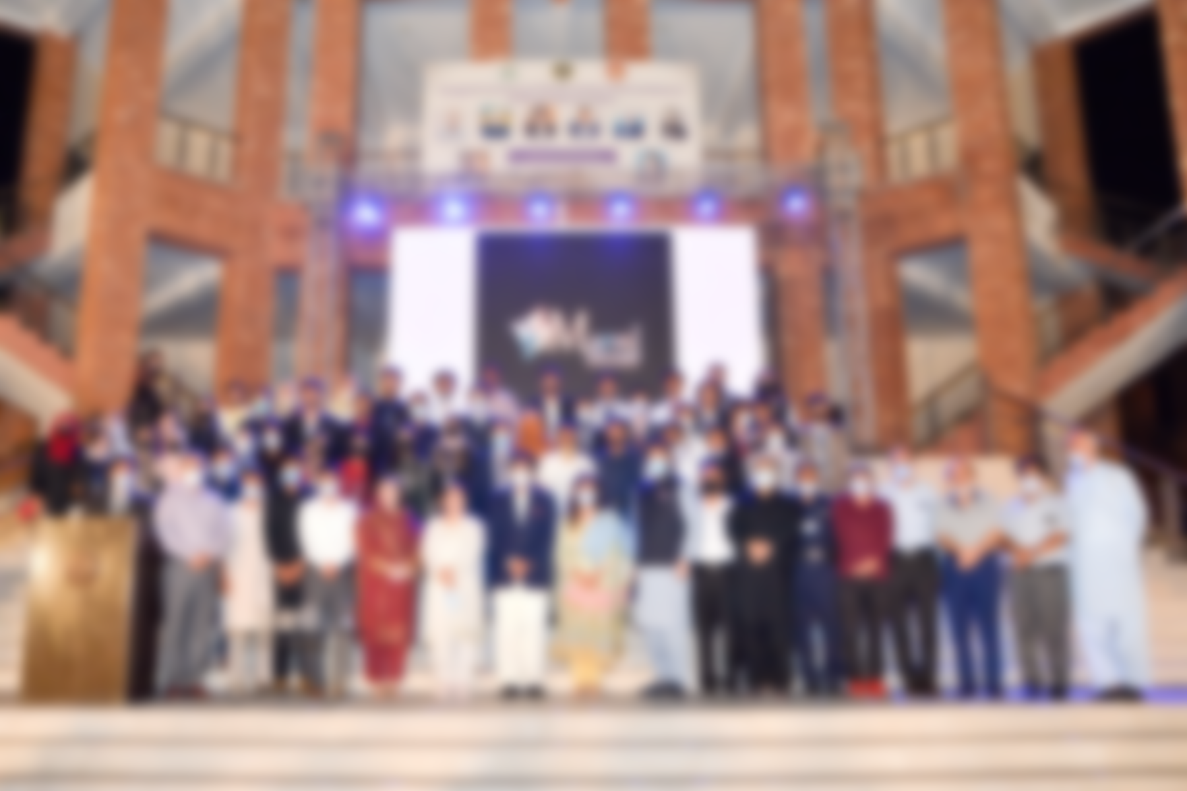
RAWALIAN COMMUNITY AWARENESS PROGRAM "A word can make the world better”
A REVIEW

Slide 2
RAWALIAN COMMUNITY AWARENESS PROGRAM
DEDICATED MY WORK
We dedicate our all work to our PROPHET MUHAMMAD (P.B.U.H).
VISION
Develop Healthy and Disease Free Community
VALUES
Preventing Diseases, Promoting Health, Prolonging Life
MOTTO
A word can make the world safer place to live !
RCAP AIM
Protecting and improving health involving combination of
community and facility based activities in community.

Slide 3
RAWALIAN COMMUNITY AWARENESS PROGRAM
RCAP OBJECTIVES
1. Initial objectives are basic preventive services, notably
immunization, access to basic drugs, and management of the most
serious threats to health, along with Health Promotion and capacity
building of Health care teams.
2. To become cost effective for prevention, referral, and management of
diseases
3. To play a key role until health services, education, income, and
communications have improved to the point that mortality/ morbidly
has fallen substantially.
4. To improve level of development of infrastructure, health services,
and socioeconomic status.
5. To achieve substantial improvement in QALY (quality adjusted life
years ) and reduction in DALY(disability adjusted life years)

Slide 4
RAWALIAN COMMUNITY AWARENESS PROGRAM
RECENT PROJECTS
World Hepatitis Day Seminar
Nurture Yourself
Safe Motherhood awareness Campaign
RMU Hepatitis free zone
Thalassemia Prevention
RMU Smoking Free Campus
World Health Day
Tuberculosis awareness
Anticancer Campaign
Road Traffic Accident awareness campaign
Osteoporosis Awareness Campaign
Breast Feeding Awareness
Anaemia Awareness Drive
Plantation Drive
Dr Ruth pfau Film Festival
Markhor fitness Club

Slide 5
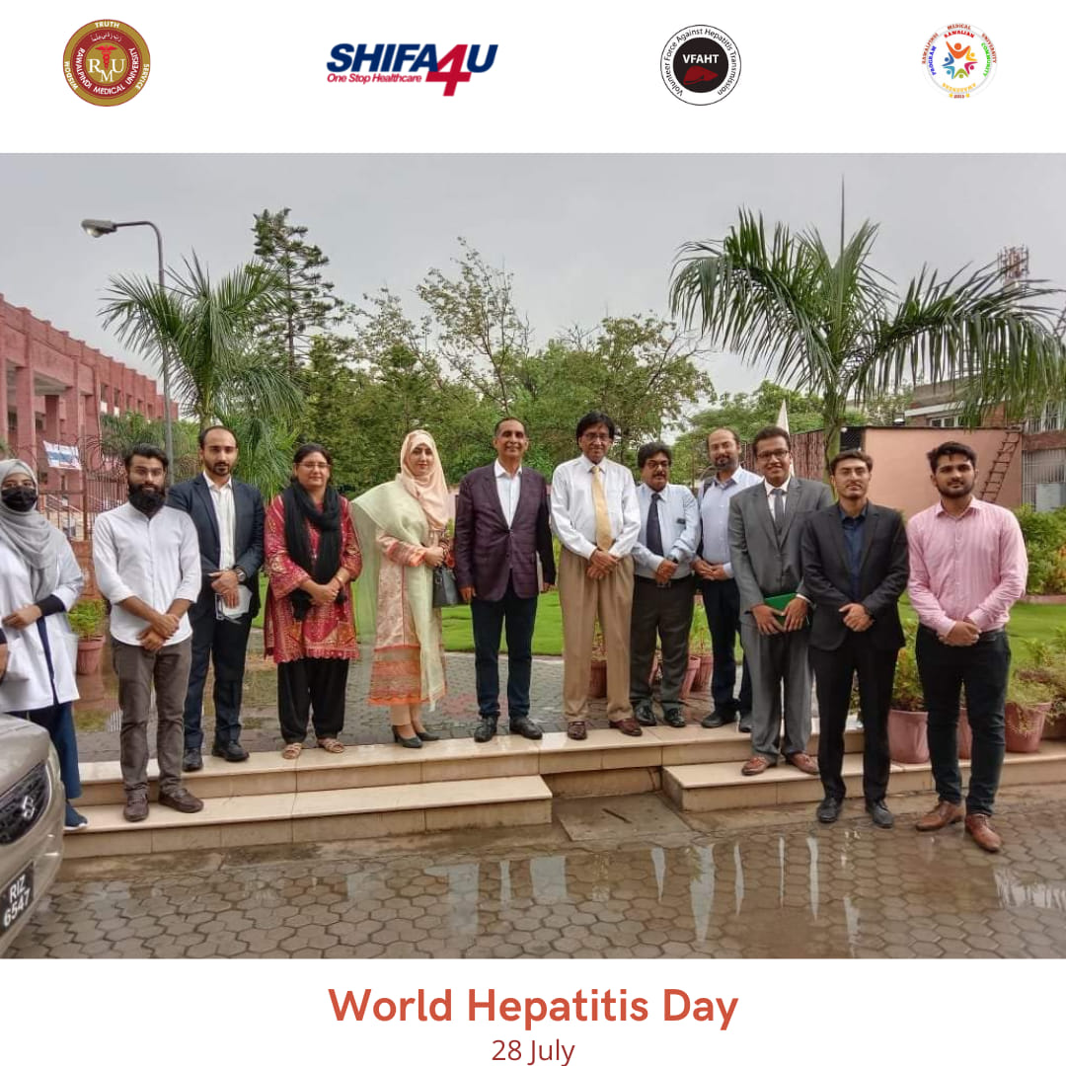
RAWALIAN COMMUNITY AWARENESS PROGRAM
World Hepatitis Day Seminar
PROJECT DETAILS
On July 27, 2022, IPAC Foundation, VFAHT, RCAP, DHA and Shifa4U organized a seminar at Rawalpindi Medical University to observe World Hepatitis Day, 2022.
Prof. Dr. Umar (SI) (Vice Chancellor, RMU), M. Sameer Shafi, MD (Chairman, Board of Trustees, IPAC Foundation), Prof. Dr. Tayyab Saeed Akhtar (Consultant, Gastroenterologist), Dr. Lubna Ishaq (CEO, District Health Authority, Rawalpindi), Dr. Ehsan Ghani (District Health Officer, Rawalpindi), and Prof. Dr. Syed Arshad Sabir (Dean of Community Medicine, RMU) were the guests at the ceremony.

Slide 6
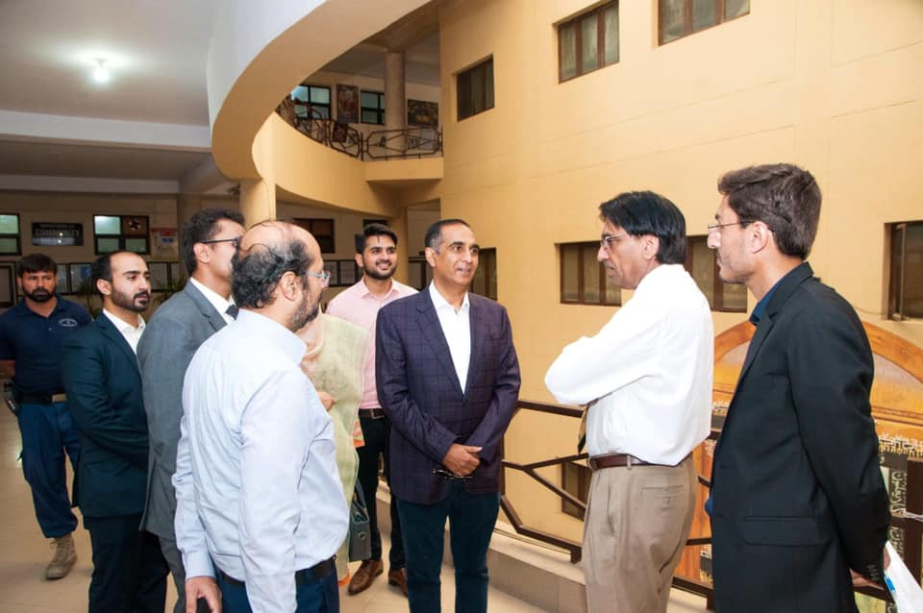
RAWALIAN COMMUNITY AWARENESS PROGRAM
World Hepatitis Day Seminar
OBJECTIVES
The purpose of this seminar was to raise awareness among the medical students regarding the importance of taking right actions at the right time. The speakers emphasized upon spreading awareness among people regarding the disease as it can be easily prevented and cured through timely diagnosis and proper treatment.

Slide 7
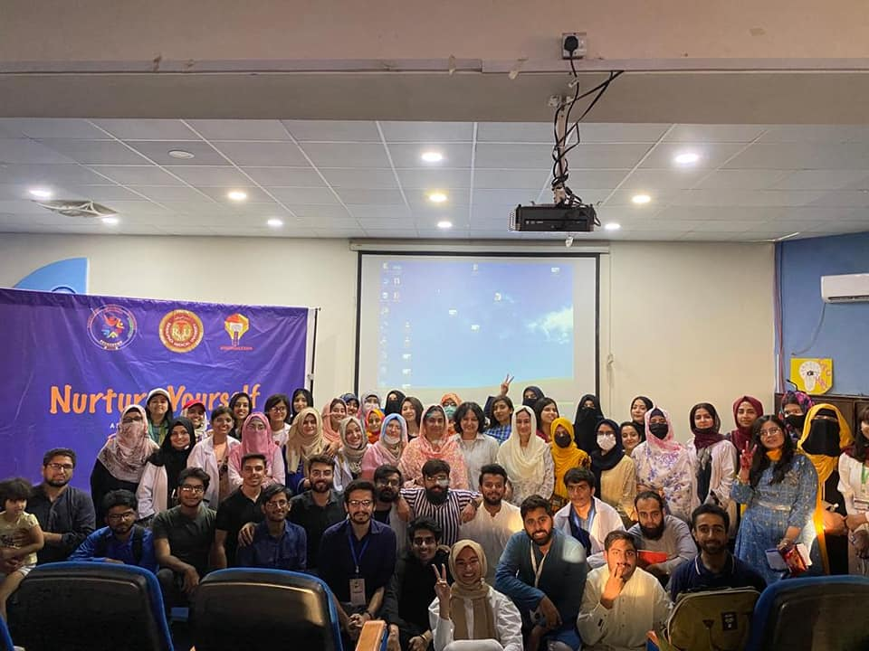
RAWALIAN COMMUNITY AWARENESS PROGRAM
Nurture Yourself
PROJECT DETAILS
NURTURE YOURSELF series of 5 sessions is not a talk, it's not a one time event. it's a way of life. A director of all the GOOD THINGS we fail to appreciate and enjoy in life
Session 1 - The Mountain is You
Session 2 - Inner Child Hearing
Session 3 - Self Worth 101
Session 4 - I Hear Your Silence
Session 5 - I See You Love

Slide 8
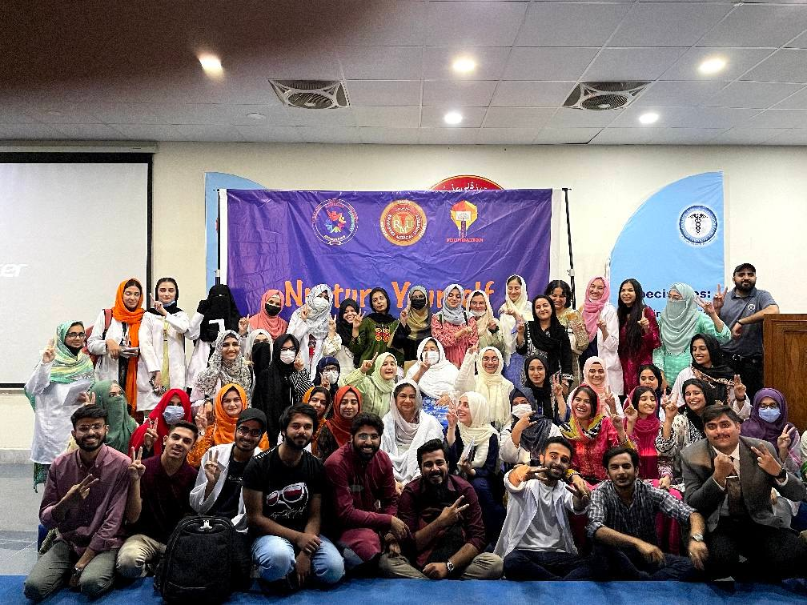
RAWALIAN COMMUNITY AWARENESS PROGRAM
Nurture Yourself
OBJECTIVES
It talks about Self Compassion. Self Love. Self Sabotage. Why we don't work towards our goals even though we want to.
The ethics of Giving and taking Effective Communication to form healthy bonds
It encourages the attendees to courageously talk about it. The first step towards Healing is to Acknowledge the issue, and then to compassionately channelize it and let it go. The attendees will be equipped with relaxation techniques to not go into a debilitating state while they talk about their rock bottoms.

Slide 9
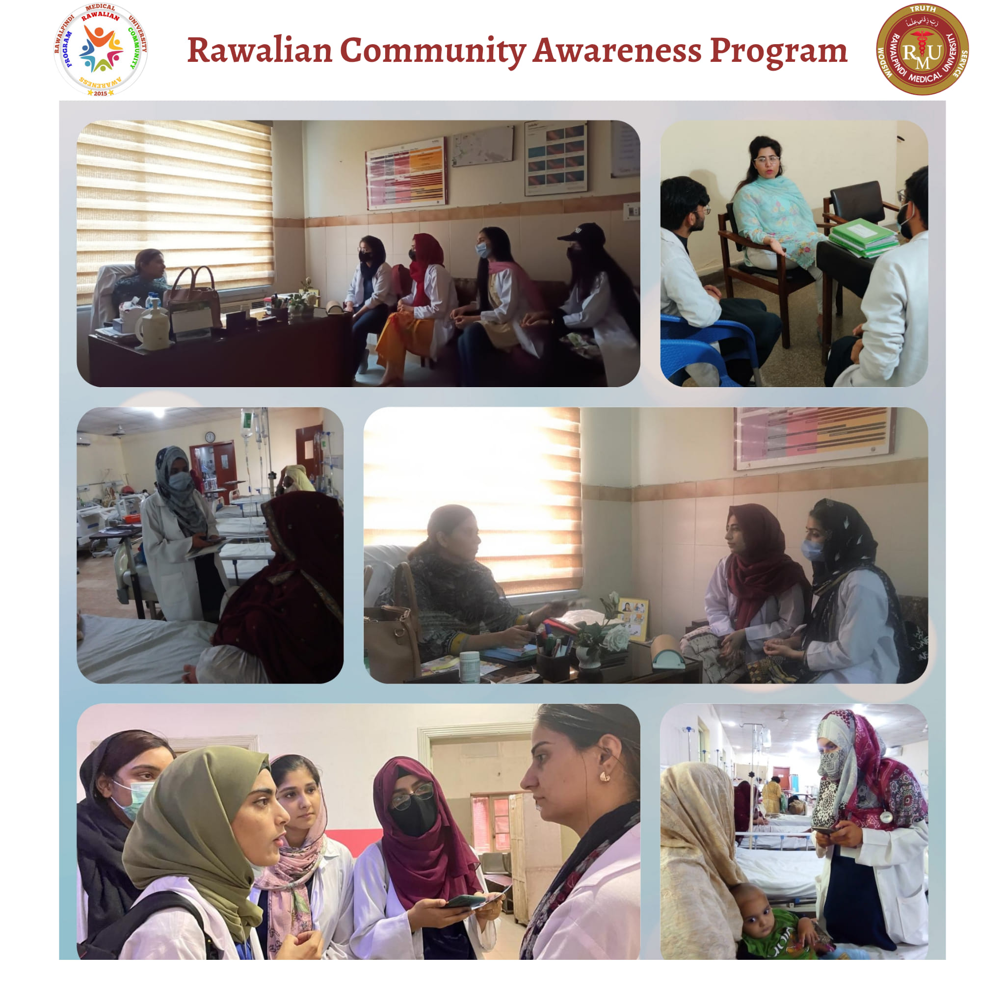
RAWALIAN COMMUNITY AWARENESS PROGRAM
SAFE MOTHERHOOD AWARENESS CAMPAIGN
PROJECT DETAILS
PHASE 1
Team RCAP had a Capacity building session for Safe motherhood awareness campaign regarding contraception and family planning, where our team members visited Gynae Wards Unit 1 & 2 of Holy Family Hospital and Gynae unit BBH, Rwp
PHASE 2
Awareness regarding family planning, contraception and distributed pamphlets

Slide 10
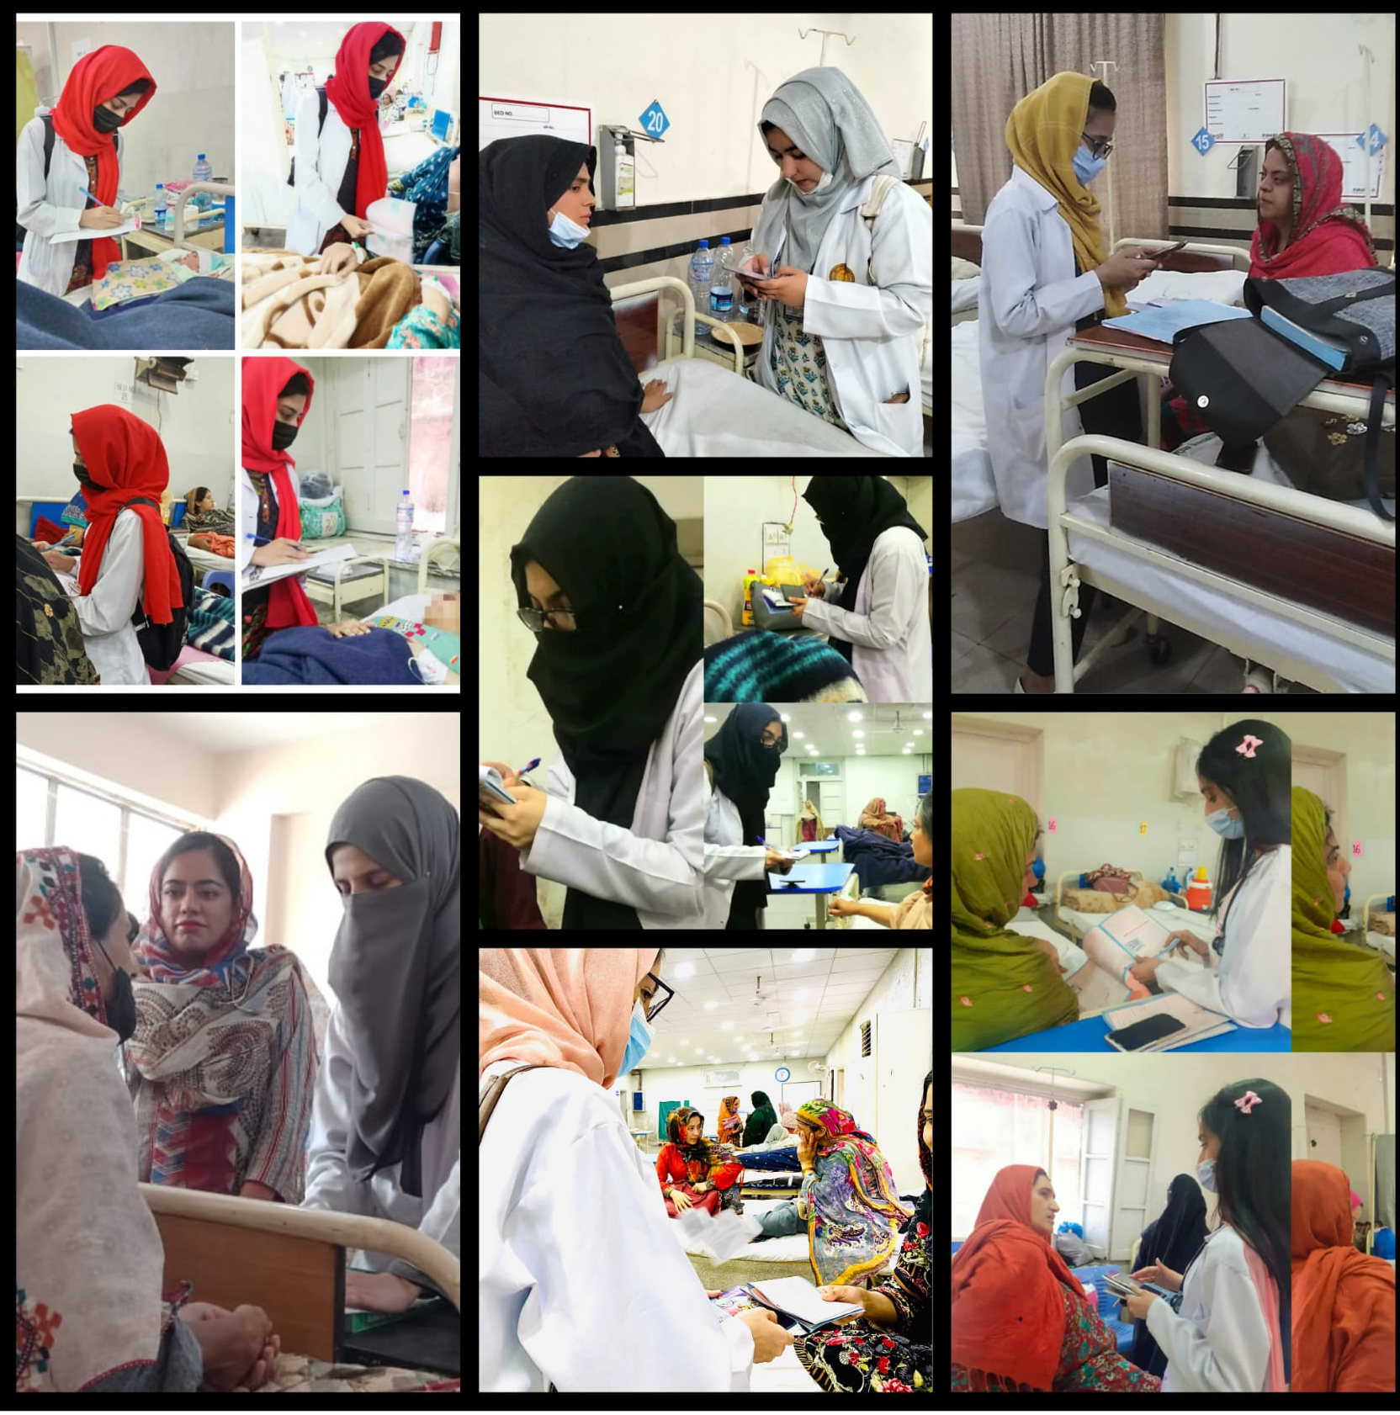
RAWALIAN COMMUNITY AWARENESS PROGRAM
SAFE MOTHERHOOD AWARENESS CAMPAIGN
OBJECTIVES
To ensuring all women receive the care they need to be safe and healthy throughout pregnancy and childbirth.
to reduce maternal and neonatal morbidity and mortality and to improve the maternal and neonatal health through preventive and promotive activities as well as by addressing avoidable factors that cause death during pregnancy, childbirth and postpartum period.

Slide 11
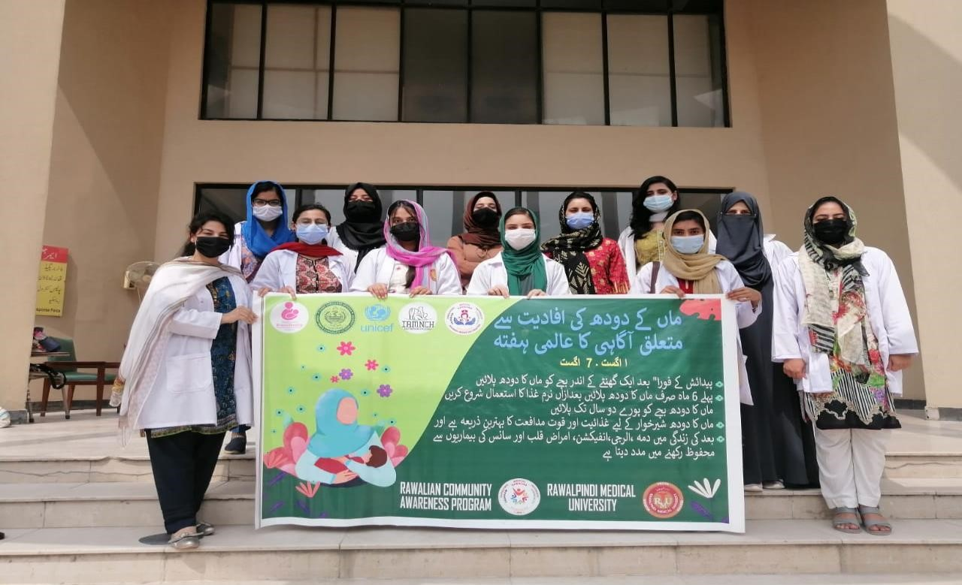
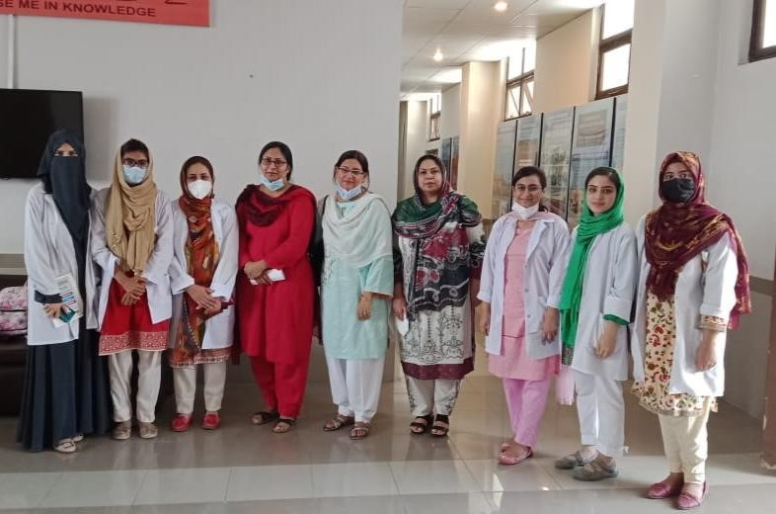
RAWALIAN COMMUNITY AWARENESS PROGRAM
BREAST FEEDING AWARENESS CAMPAIGN
PROJECT DETAILS
Capacity building session of team members by Dr. Hina (Gynecology department BBH), Dr. Sobia(DHQ ) and Dr. Madiha (HFH) Dr. Assad Shabbir (Pediatrics)
Awareness session conducted successfully at post neonatal wards and pediatrics wards of BBH, HFH and DHQ hospital Rawalpindi.
Video messages

Slide 12
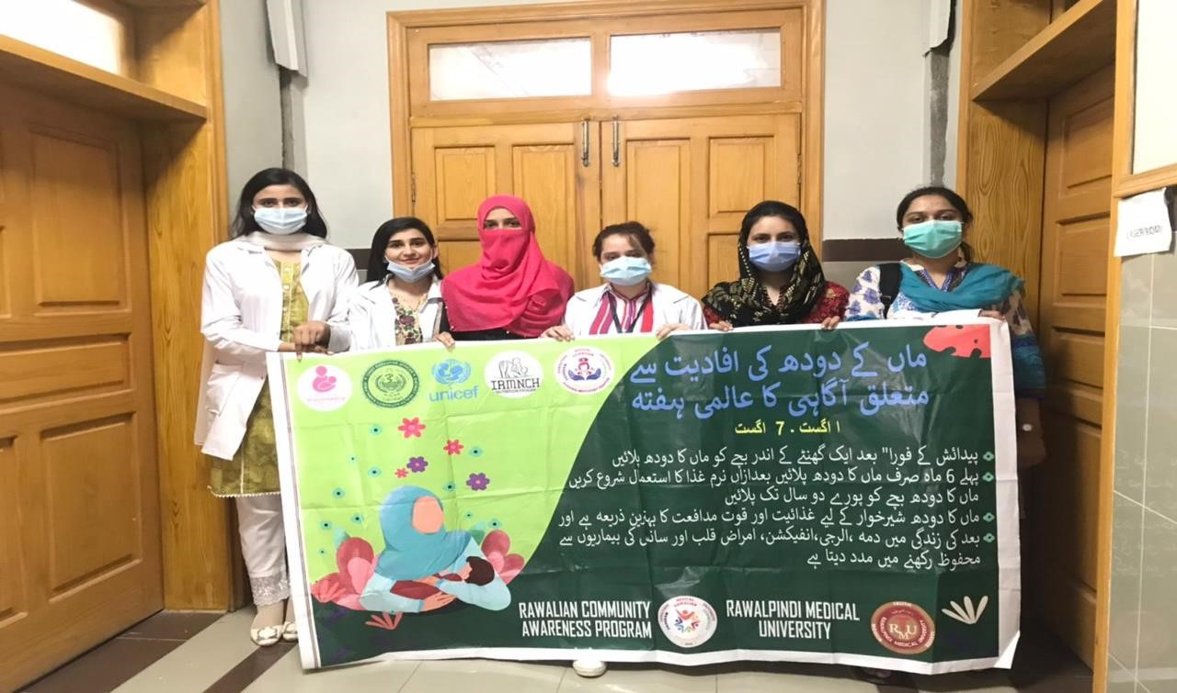
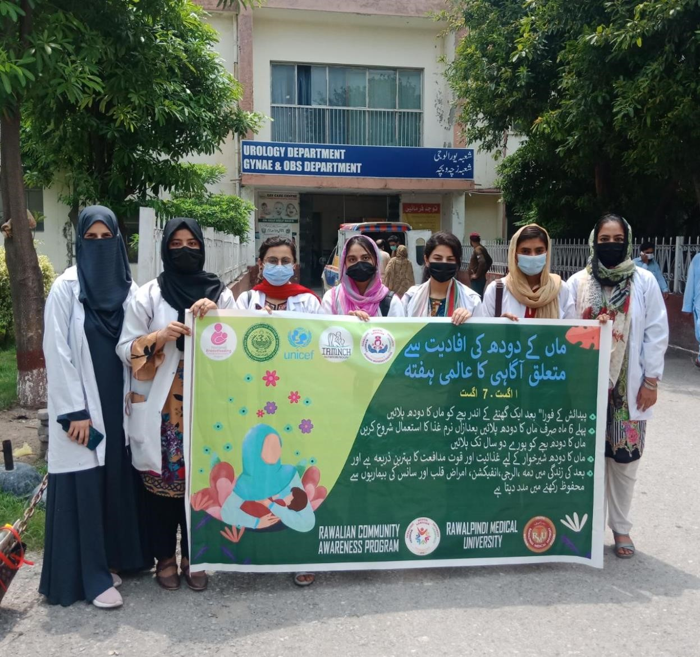
RAWALIAN COMMUNITY AWARENESS PROGRAM
BREAST FEEDING AWARENESS CAMPAIGN
OBJECTIVES
Discuss the importance and management of breastfeeding with pregnant women and their families.
Facilitate immediate and uninterrupted skin-to-skin contact and support mothers to initiate breastfeeding as soon as possible after birth.
Support mothers to initiate and maintain breastfeeding and manage common difficulties.
Do not provide breastfed newborns any food or fluids other than breast milk, unless medically indicated.
Enable mothers and their infants to remain together and to practice rooming-in 24 hours a day.
Support mothers to recognize and respond to their infants’ cues for feeding. Counsel mothers on the use and risks of feeding bottles, teats and pacifiers.

Slide 13
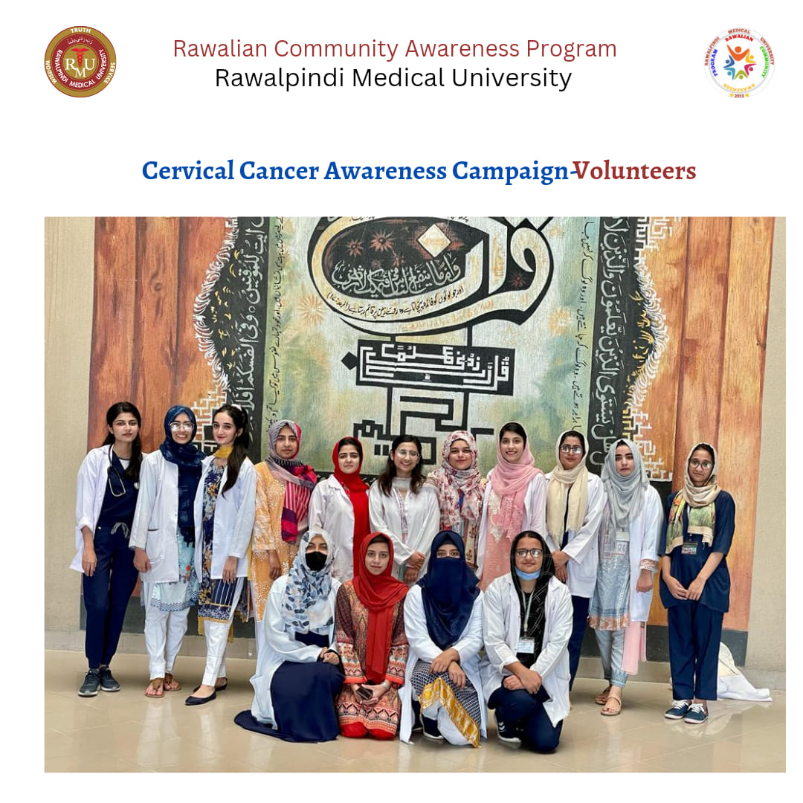
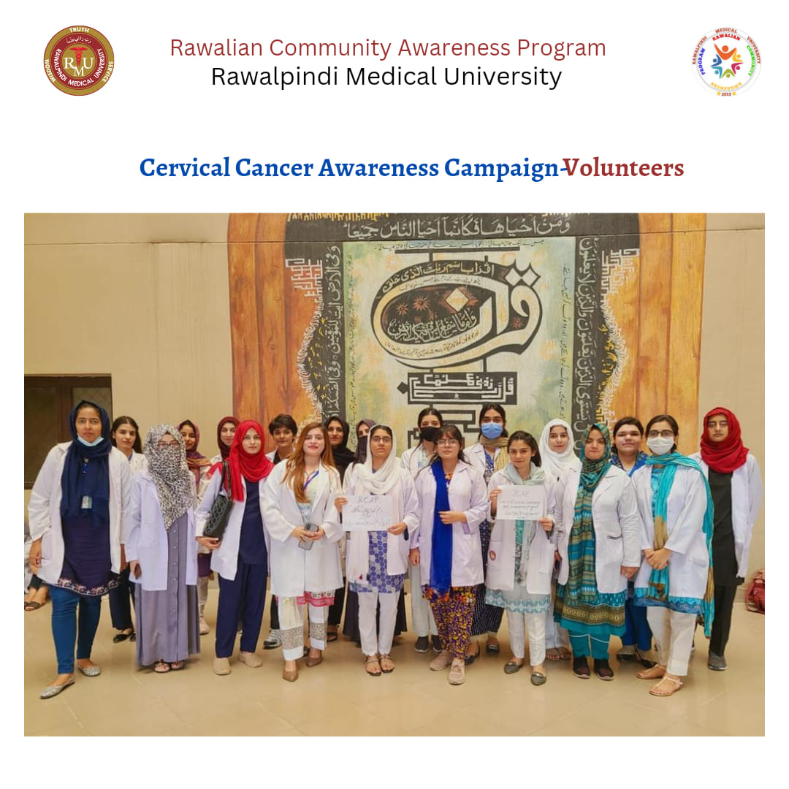
RAWALIAN COMMUNITY AWARENESS PROGRAM
Screening CERVICAL CANCER campaign
OBJECTIVES
Rawalian Community Awareness Program conducted an awareness campaign in allied hospitals of Rawalpindi Medical University i.e DHQ, BBH and HFH regarding Cervical cancer and its screening. About 50 volunteers participated and covered more than 500 patients alongside some spreading awareness at homes and university among the people.
Vaccination against HPV and screening and treatment of pre-cancer lesions is a cost-effective way to prevent cervical cancer.

Slide 14
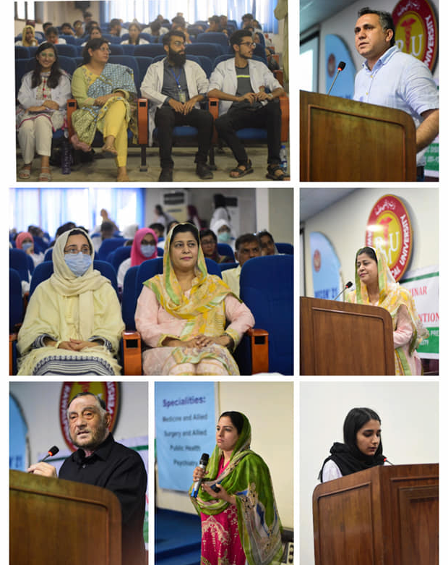
RAWALIAN COMMUNITY AWARENESS PROGRAM
THALESSAEMIA PREVENTION CAMPAIGN
PROJECT DETAILS
Rawalian Community Awareness Program (RCAP) conducted "Thalassemia Prevention and Awareness Seminar" In-collaboration with Punjab Thalassemia and other Genetic Disorders and Research Institute on Tuesday 31st of May 2022.
Our worthy Vice Chancellor Prof. Dr. Muhammad Umar & our special guests ,Col.(Dr) Mehreen Ali Khan, Prof Dr. Saima Khan addressed to the seminar. Special thanks to Dr Omaima Asif for organizing a successful seminar.

Slide 15
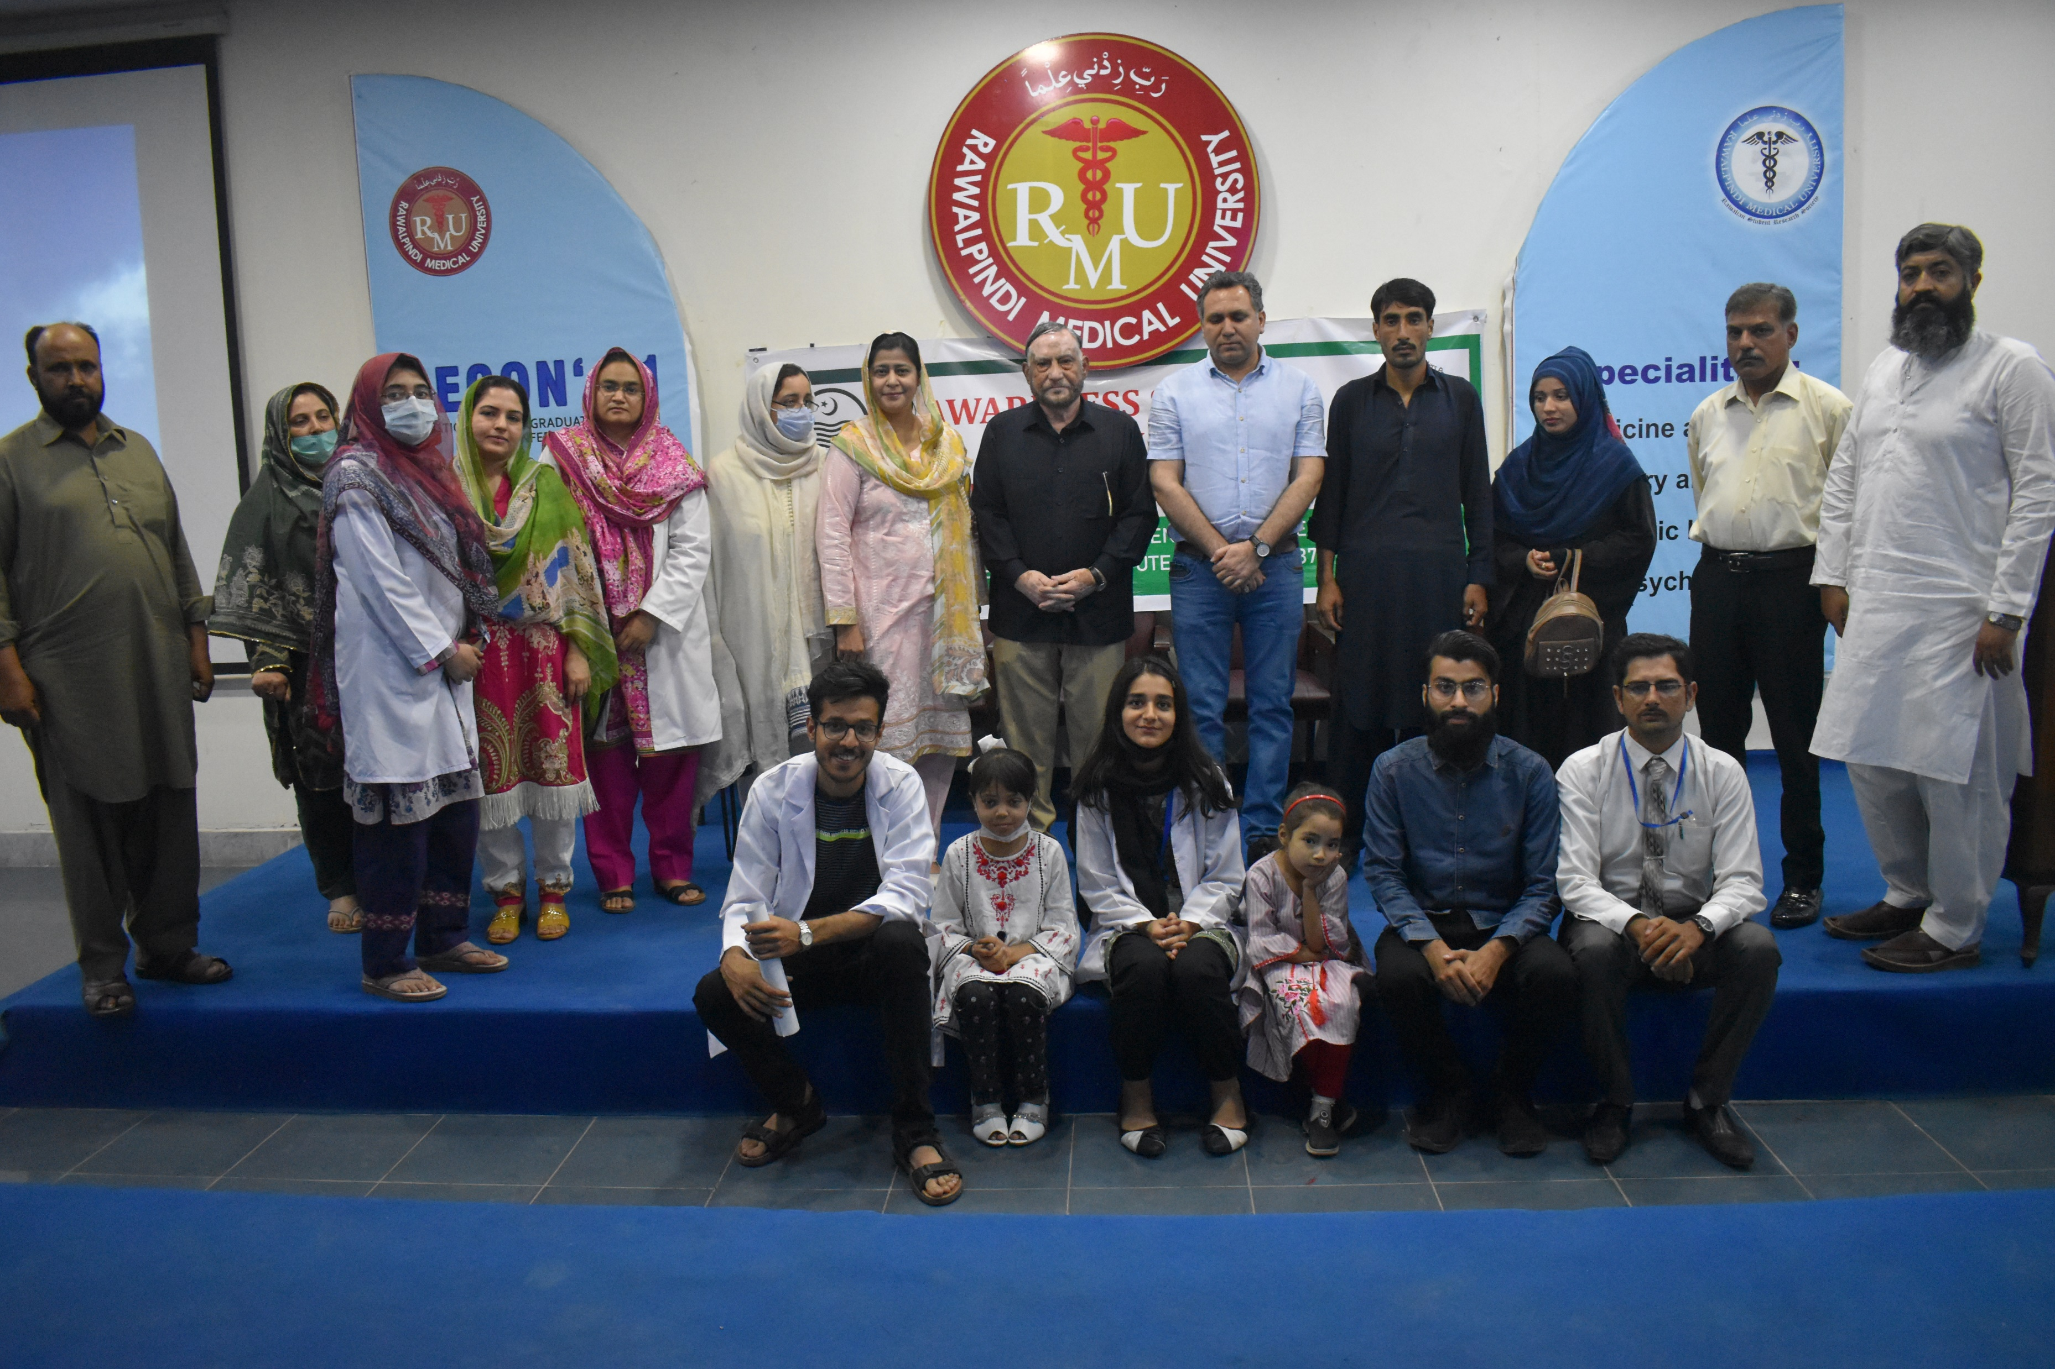
RAWALIAN COMMUNITY AWARENESS PROGRAM
THALESSAEMIA PREVENTION CAMPAIGN
OBJECTIVES
To reduce the socio-economic burden on the society and state caused due to Thalassemia sufferers. To reduce the burden of very sick patients on the infrastructure and human resource available in hospitals. To reduce the heart ordeal of parents who lose their children due to this disease.

Slide 16
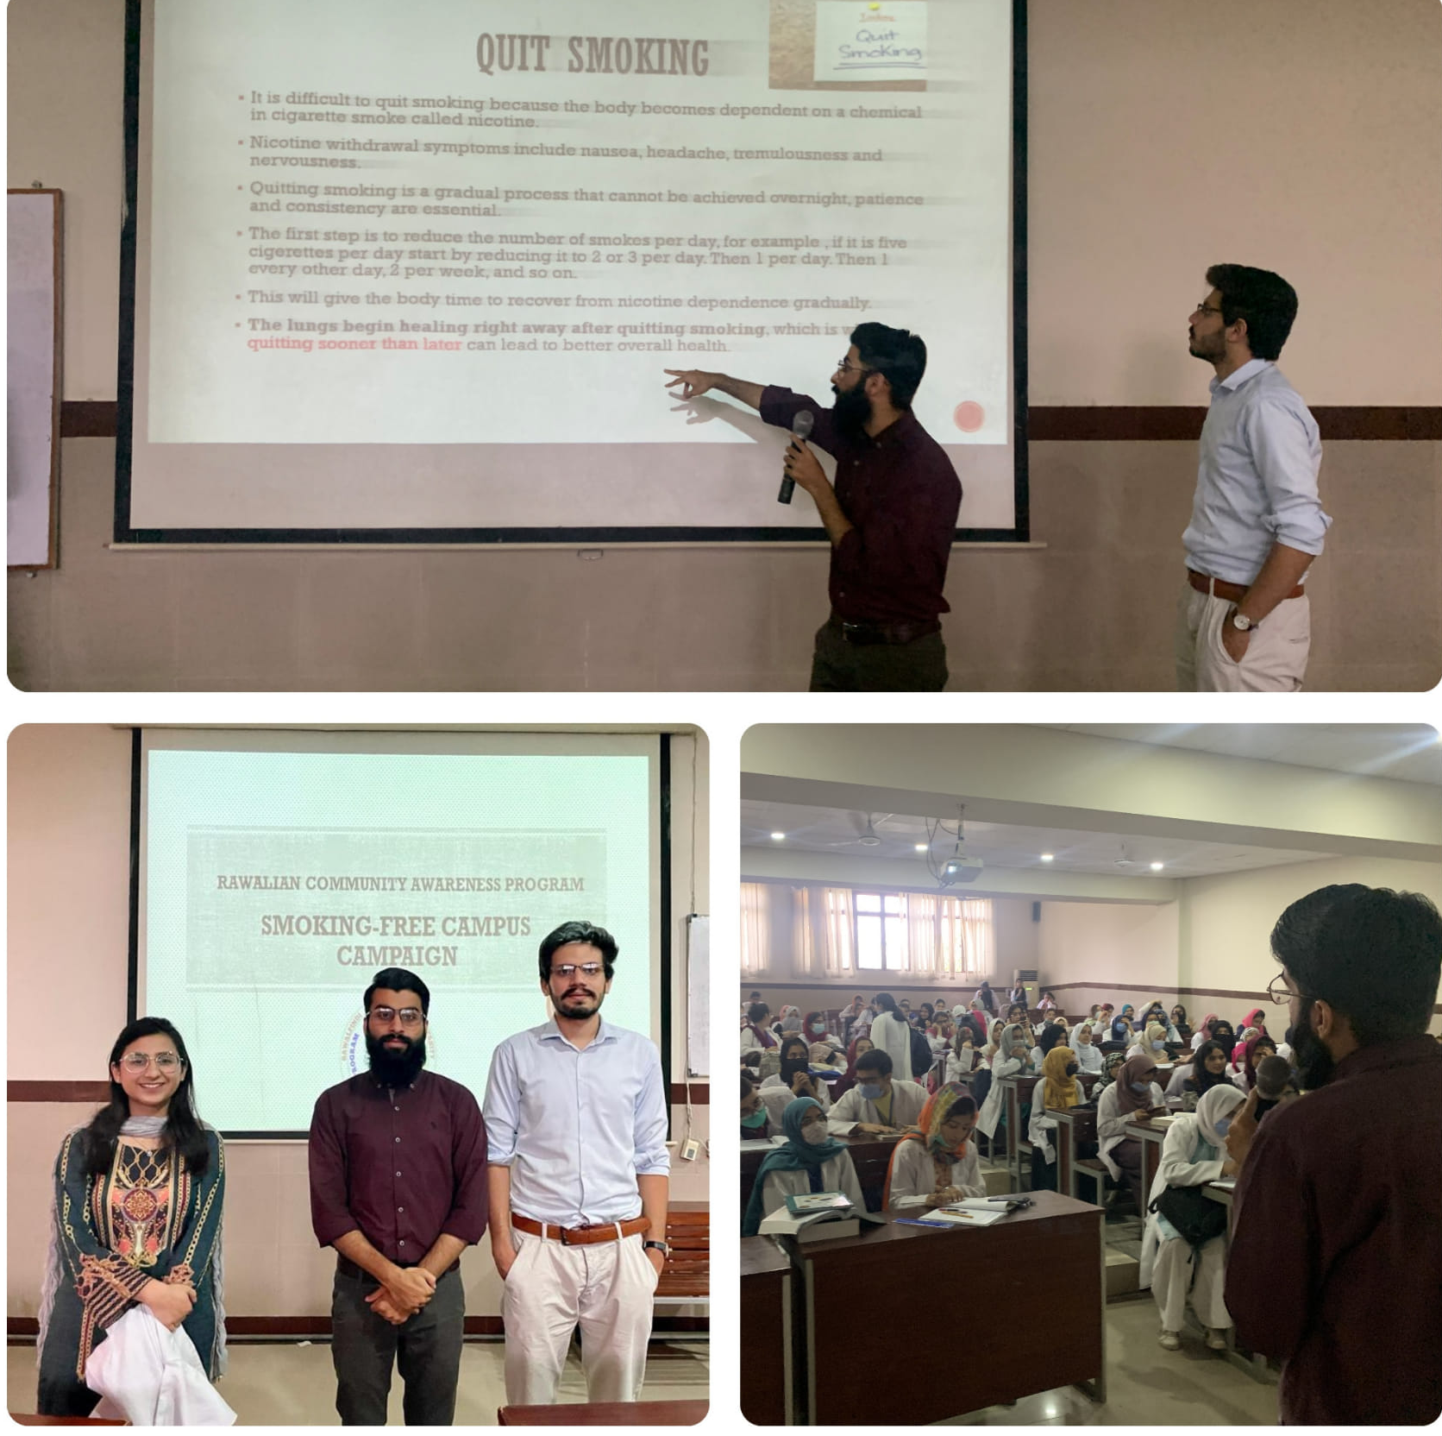
RAWALIAN COMMUNITY AWARENESS PROGRAM
SMOKE FREE CAMPUS CAMPAIGN
PROJECT DETAILS
Ramzan Smoking quitting Month Smoking-free Campus Campaign A session by RCAP in regards to smoking quitting month campaign was held on April 19th, 2022, in NTB, RMU.

Slide 17
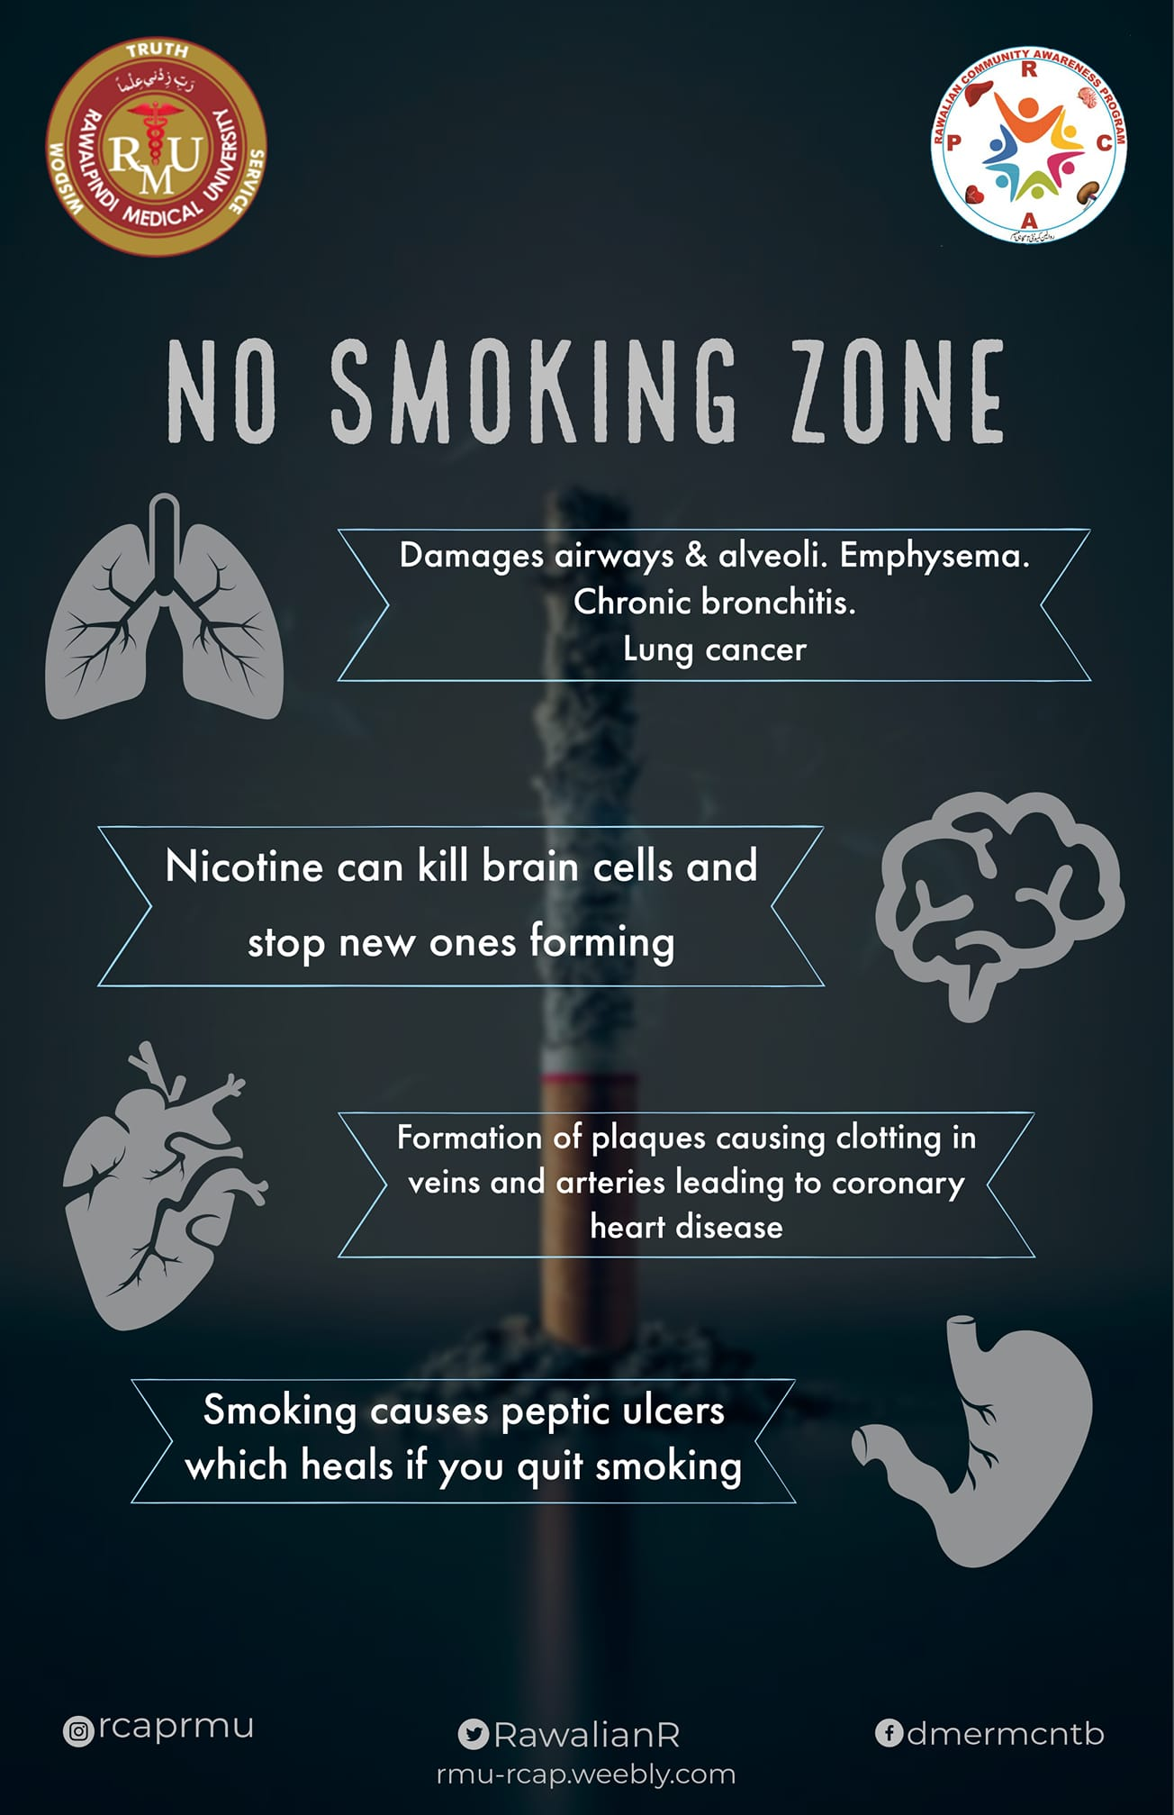
RAWALIAN COMMUNITY AWARENESS PROGRAM
SMOKE FREE CAMPUS CAMPAIGN
OBJECTIVES
The campaign and session mainly aimed at helping students understand the harms of smoking, support a #smokingfreecampus and help smokers quit smoking in the way that best suits them. Team RCAP also taught students some highly effective ways to reduce smoking rates in the community.
PHASE 2…..??? OTB

Slide 18
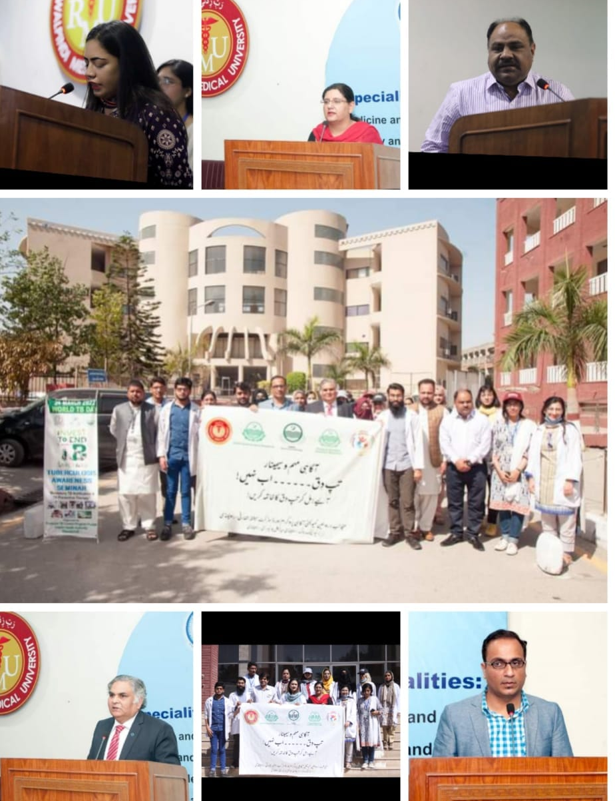
RAWALIAN COMMUNITY AWARENESS PROGRAM
TUBERCULOSIS AWARENESS CAMPAIGN
PROJECT DETAILS
RCAP held a Tb Awareness Seminar today in Rawalpindi Medical University in collaboration with District Health Authority Rawalpindi to discuss prevalence, modes of transmission , early diagnosis and treatment. Experts from different departments were also there who shared their views . We are grateful to : Dr Muhammad Raza District TB Coordinator DHA Rawalpindi Dr Muhammad Mujeeb Khan
Patron Communicable Diseases RCAP Dr Muhammad Zubair District Training officer TB prevention and control Mr Rashid Hussain Deputy Head Orthotics & Prosthetics BBH RMU

Slide 19
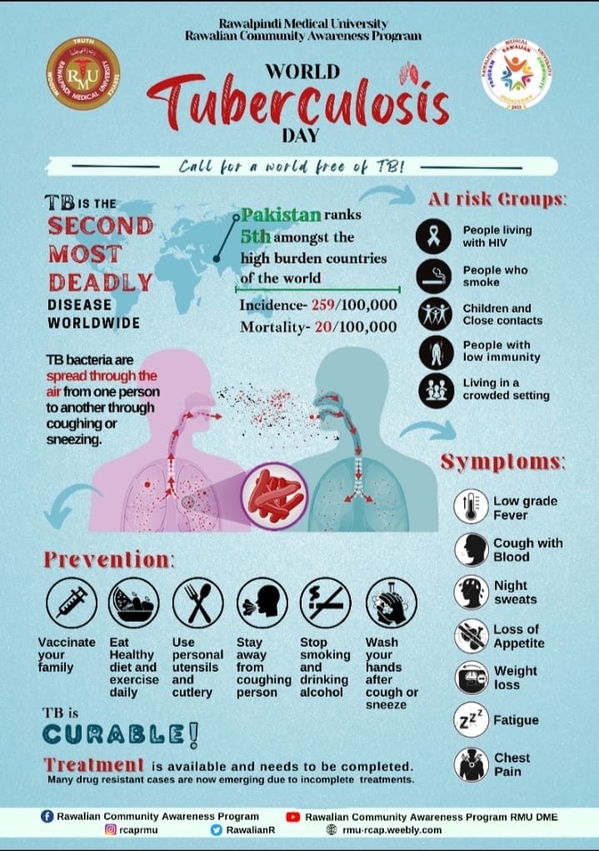
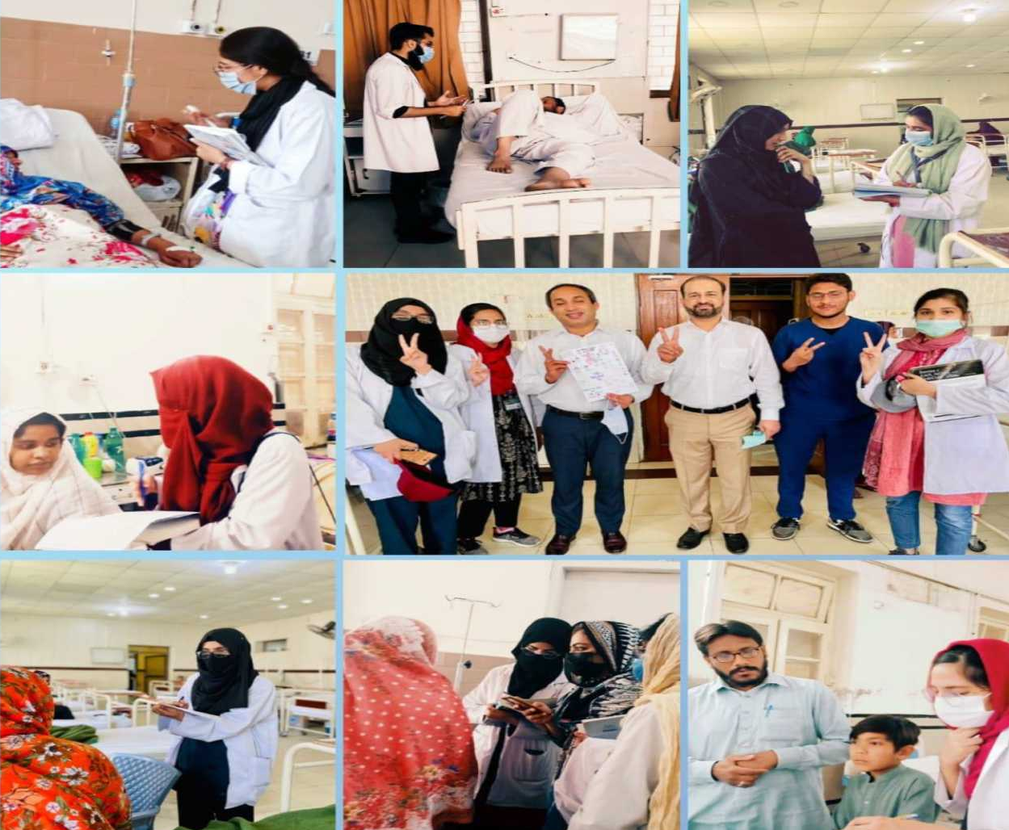
RAWALIAN COMMUNITY AWARENESS PROGRAM
TUBERCULOSIS AWARENESS CAMPAIGN
OBJECTIVES
* Capacity building session of team members.
* Awareness sessions in OPDs,wards of different Allied Hospitals of RMU.
* Short Video messages by HODs of ENT departments.
* Awareness seminar
* Awareness walk

Slide 20
RAWALIAN COMMUNITY AWARENESS PROGRAM
ANAEMIA AWARENESS CAMPAIGN
PROJECT DETAILS
The Volunteers were divided into two teams & sent to HFH and BBH accompanied by respected members from Bio-labs. Drive started around 9am as of Thursday 16th December 2021. The members were provided with awareness pamphlets and research questionnaire. Volunteers spread awareness about anemia and also collected data regarding anemia risk factors, iron deficiency, adverse outcomes etc. about hundred research forms were collected and around three hundred people were made aware of anemia in a single day.

Slide 21
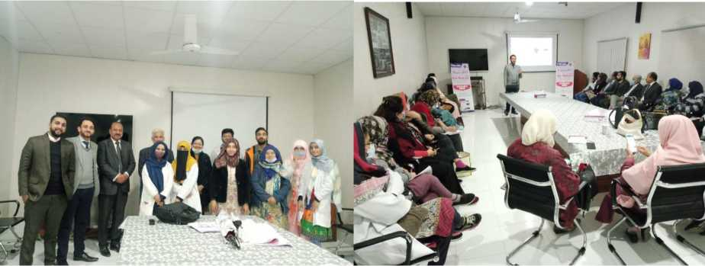
RAWALIAN COMMUNITY AWARENESS PROGRAM
ANAEMIA AWARENESS CAMPAIGN
OBJECTIVES
Organizing an awareness campaign
Organizing volunteers to visit pediatrics & gynae wards of HFH & BBH for Awareness & research activity
Distributing Pamphlets of anemia awareness among mothers and general public.
To educate public, mothers & pregnant females about Anemia To check Prevalence of Anemia in Mothers To determine adverse possible outcomes of Anemia To study Iron Deficiency Anemia in Infants and young children.

Slide 22
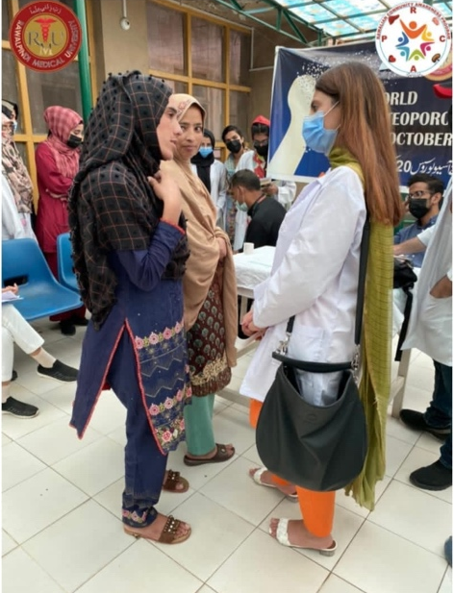
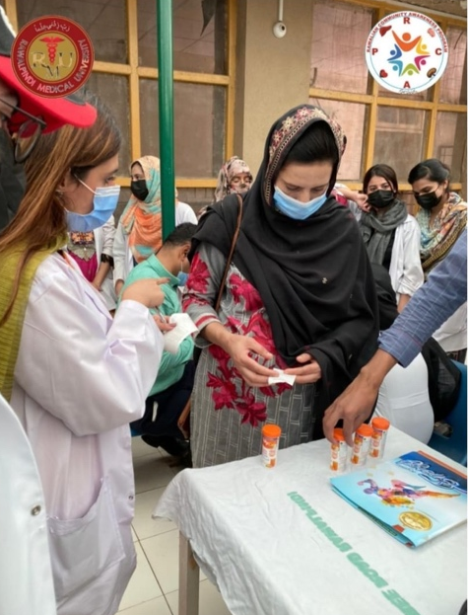
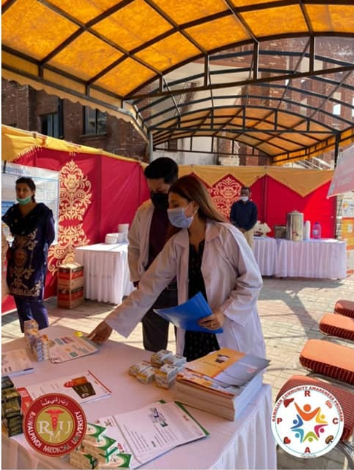
RAWALIAN COMMUNITY AWARENESS PROGRAM
OSTEOPOROSIS AWARENESS CAMPAIGN
PROJECT DETAILS
RCAP (Rawalian Community Awareness Program) organised a Bone Density Screening Camp at Benazir Bhutto Hospital on 22nd October 2021 in commemoration of World Osteoporosis Day.

Slide 23
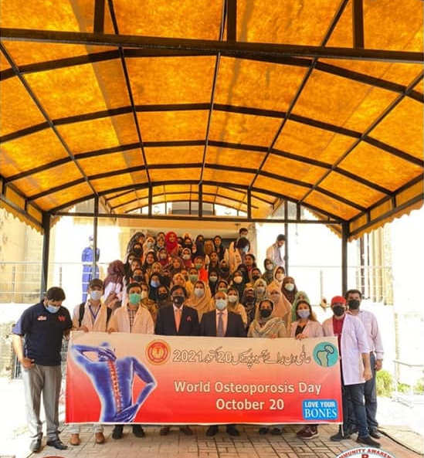
RAWALIAN COMMUNITY AWARENESS PROGRAM
OSTEOPOROSIS AWARENESS CAMPAIGN
OBJECTIVES
To determine the risk of osteoporosis in the participants.
To determine how many grams of calcium and other minerals are packed in bones. To prevent the risk of fractures by modifying the lifestyle.
To use the results of bone density tests and plan the treatment modality.
To determine the population ratio at a potential risk of osteoporosis.

Slide 24
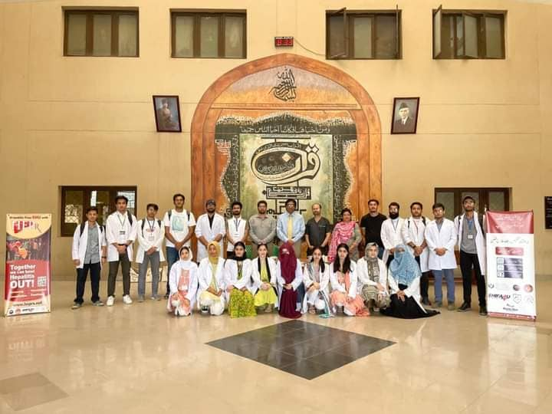
RAWALIAN COMMUNITY AWARENESS PROGRAM
RMU HEPATITIS FREE ZONE
PROJECT DETAILS
Hepatitis B and C screening camp was arranged in New Teaching Block Rawalpindi Medical University by VFAHT (Volunteer Force Against Hepatitis Transmission) in collaboration with Rawalian Community Awareness Program, Shifa4U, CLD & Martin Dow. Up to 270 students were screened, all of whom turned negative. This was the first camp of Phase 1 of RMU Hepatitis Free Zone project. The camp was conducted under the supervision of Vice Chancellor Prof. Dr. Muhammad Umar (TI) and the guidance of Dr. Tayyab Rasool, Dr Omaima Asif & Dr Asif.

Slide 25
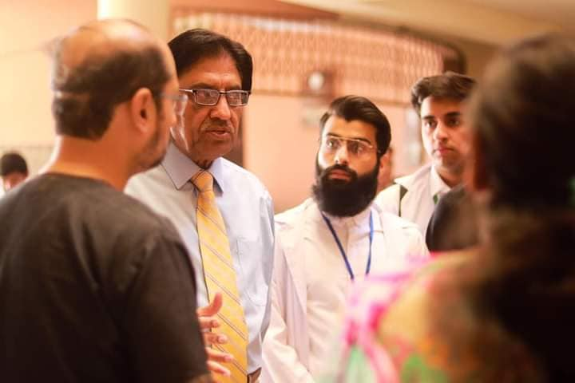
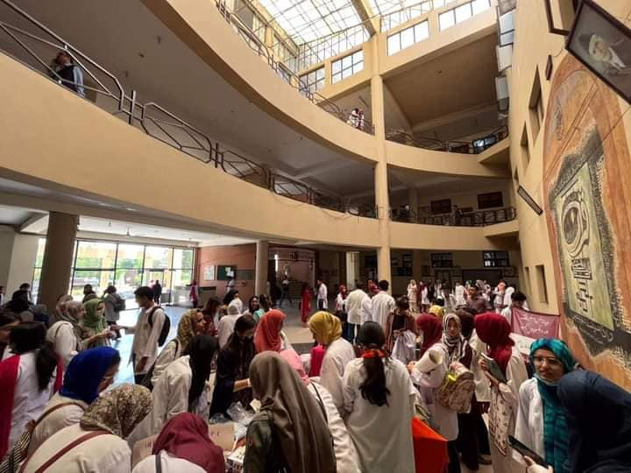
RAWALIAN COMMUNITY AWARENESS PROGRAM
RMU HEPATITIS FREE ZONE
OBJECTIVES
Rawalpindi Medical University is considered one of the leading institutes in the country in extending awareness of spread, treatment and prevention of hepatitis among mass communities and locals.
To make RMU hepatitis free zone
To screen all students and faculty of RMU.

Slide 26
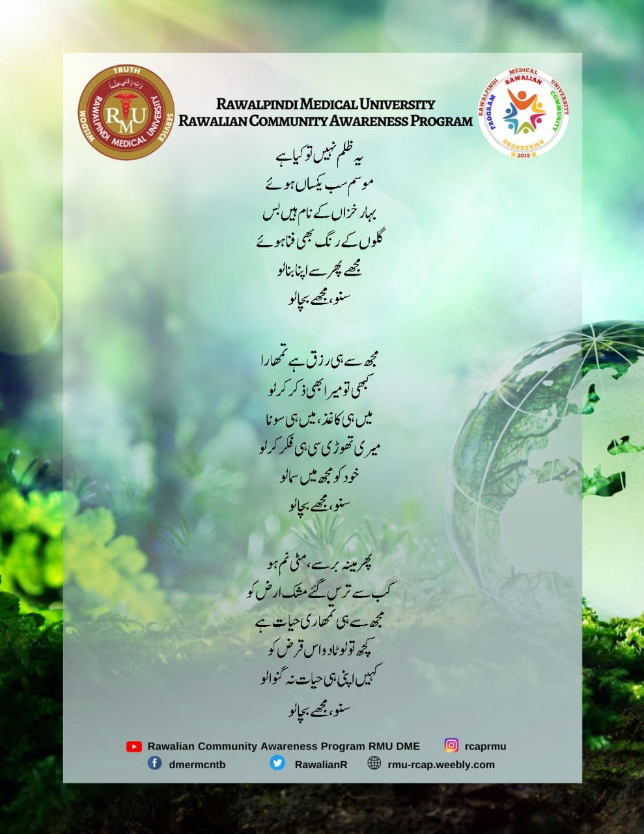
RAWALIAN COMMUNITY AWARENESS PROGRAM
WORLD HEALTH DAY
PROJECT DETAILS
Theme of this year is Our Planet Our Health

Slide 27
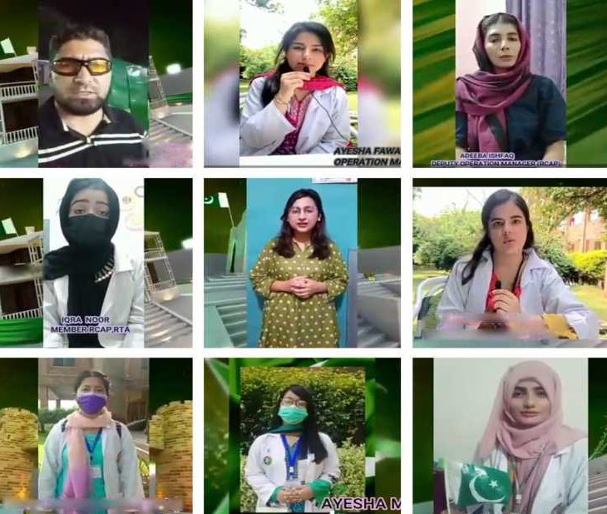
RAWALIAN COMMUNITY AWARENESS PROGRAM
RTA AWARENESS CAMPAIGN
PROJECT DETAILS
Ride Safe, Arrive Safe
An accident is an unforeseen, unexpected event that may result in mortality (death), morbidity (condition of being diseased), disability, and economic loss. Globally accidents are the 8th leading cause of death and are responsible for about 8% of all deaths in the world. According to UN survey, Pakistan ranks 4th in vehicle accidents. These alarmingly high trends indicate the severity of threat RTAs impose on public health. As NTRC (National Transport Research Centre) states, there are three main causes of road traffic accidents i.e., ignorance of road users, outmoded traffic, ineffective enforcement of traffic laws.

Slide 28
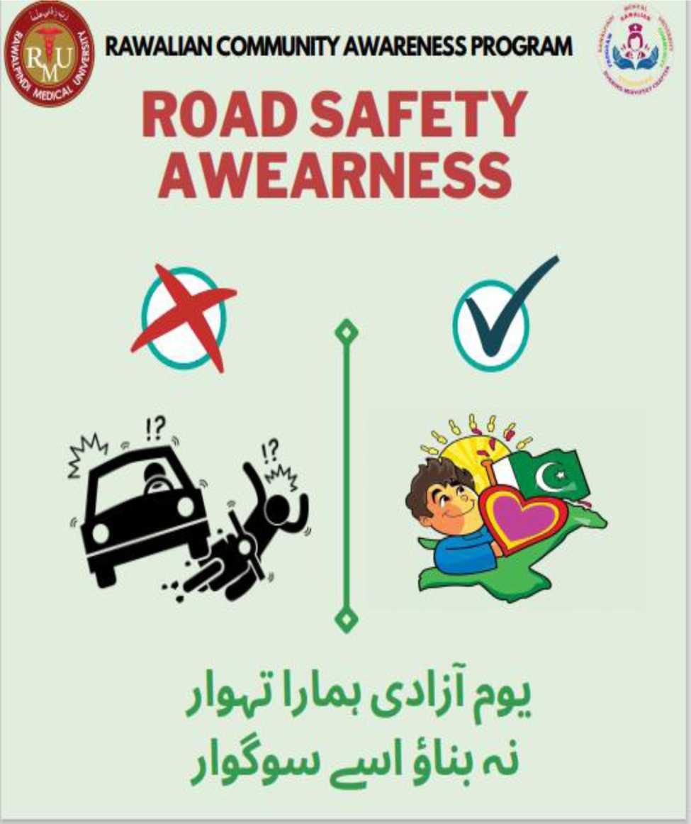
RAWALIAN COMMUNITY AWARENESS PROGRAM
RTA AWARENESS CAMPAIGN
OBJECTIVES
Promotion of safety tips for road traffic accidents prevention STRAPS.
Following the speed limit
Safety promotion for all major categories for road users:
Pedestrians
Bicyclists and cyclists
Drivers of cars, auto-rickshaws, truck drivers etc.
Reduce the number of accidents and associated:
Mortalities
Morbidities and disability
Economic loss due to RTAs
Make the roads of Pakistan safe.

Slide 29
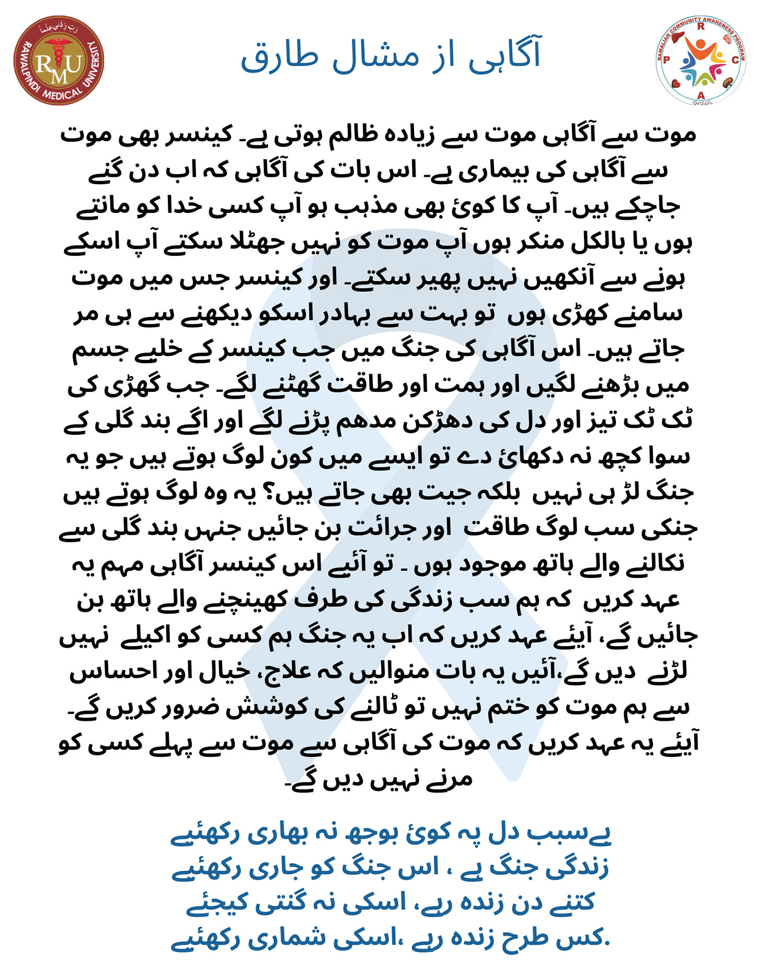
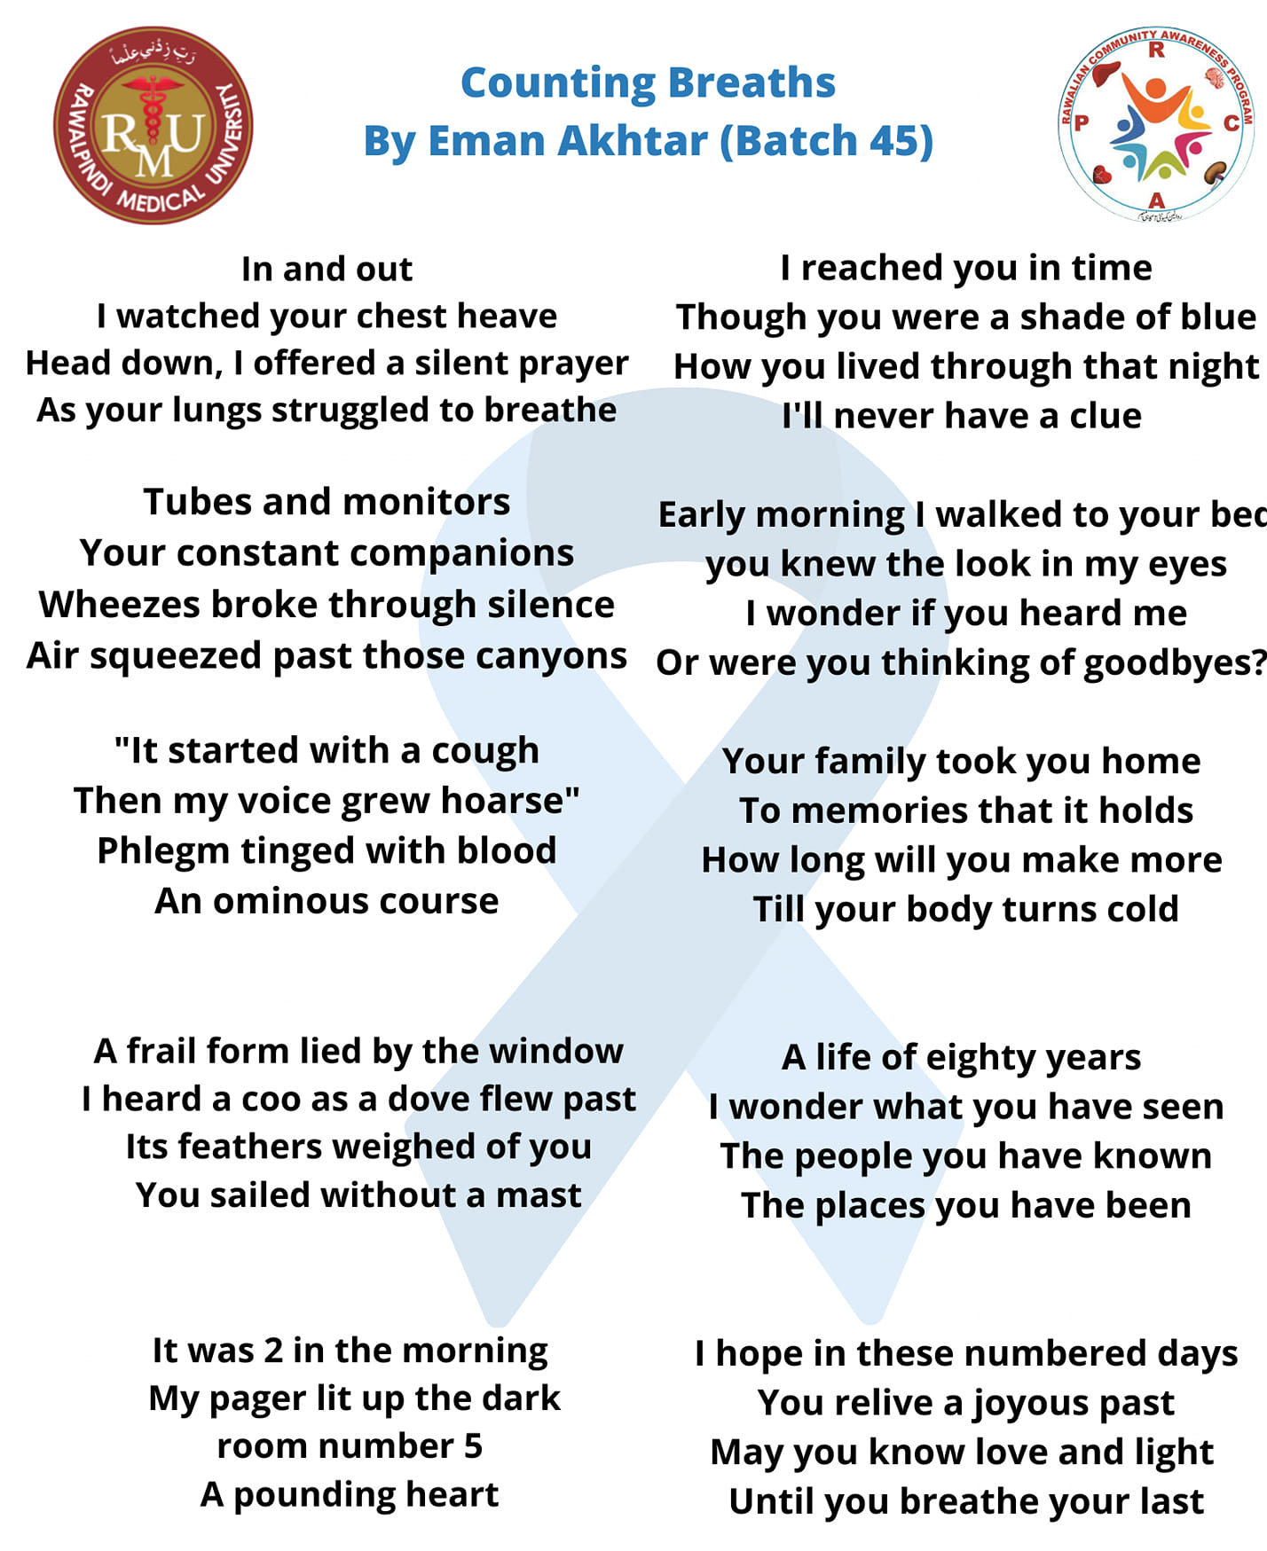
RAWALIAN COMMUNITY AWARENESS PROGRAM
ANTI CANCER CAMPAIGN

Slide 30
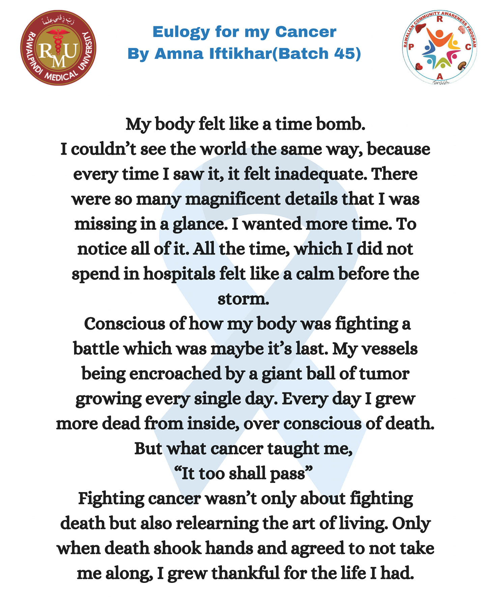
RAWALIAN COMMUNITY AWARENESS PROGRAM
ANTI CANCER CAMPAIGN

Slide 31
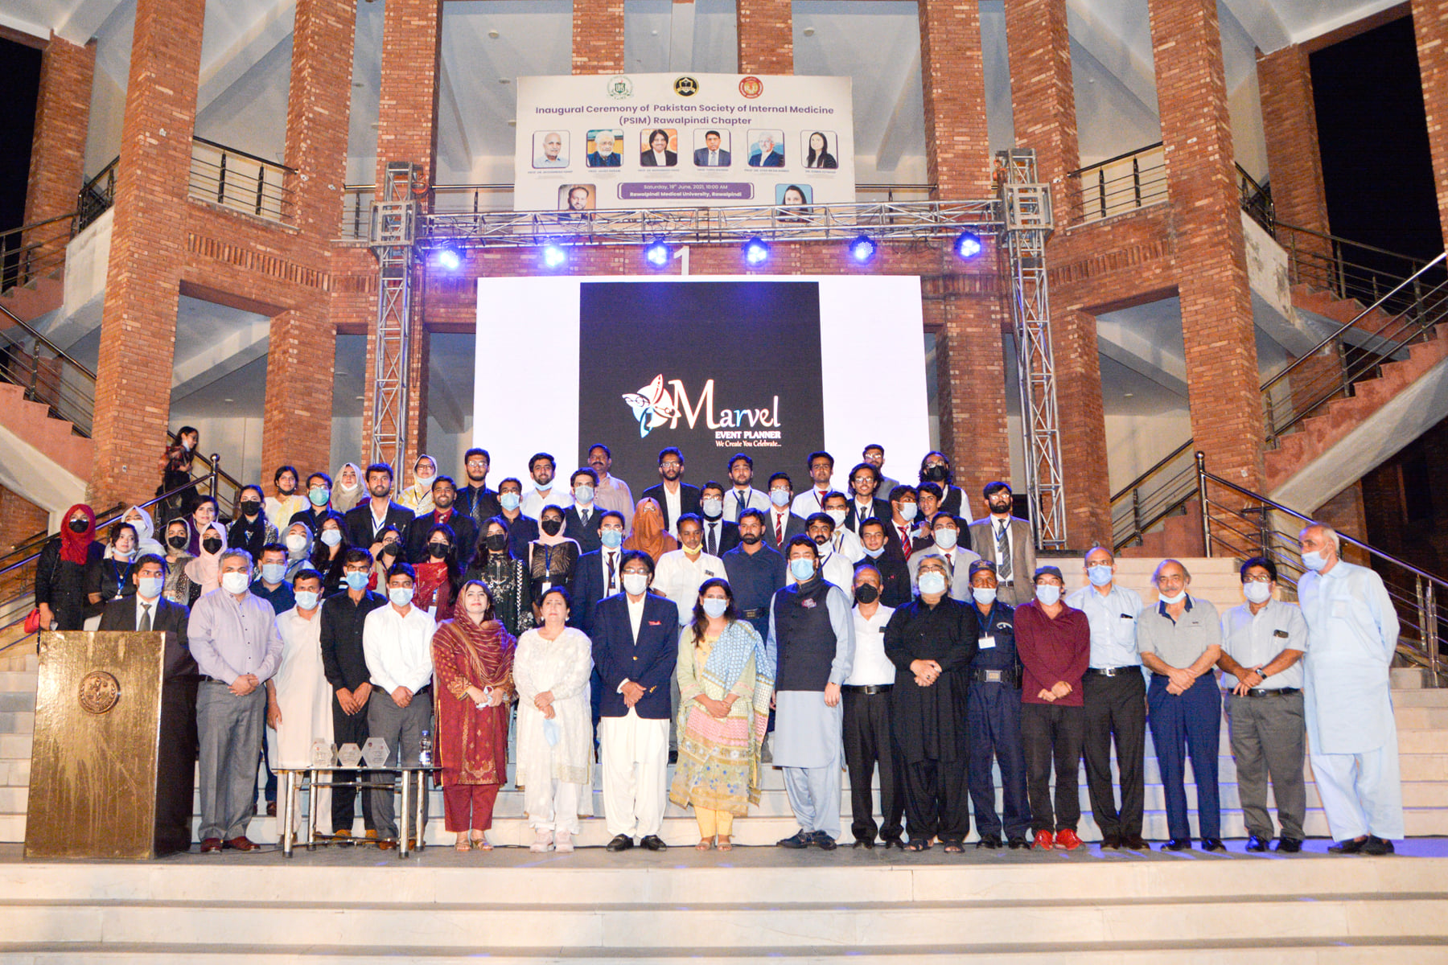
RAWALIAN COMMUNITY AWARENESS PROGRAM
DR RUTH PFAU FILM FESTIVEL
PROJECT DETAILS
A healthy competition was introduced among the movie makers to ensure high quality movies. Winners were decided by the esteemed Judi that included Ehd e Wafa and Load wedding famed, award winning actor Anjum Habibi, and one of the famous producers and writers in the industry – Tanveer Sardar, who has many celebrated TV shows to his name.
Shahryar Khan Afridi and Dr. Prof Muhammad Umar, VC RMU were invited as chief guests. A total of 13 movies were submitted out of which top 3 movies were given cash prizes of 15k, 10k and 5k respectively. First position was scored by the students of Army Medical College, second and third by Rawalpindi Medical University students. The session ended on a note by our respected chief guests.

Slide 32
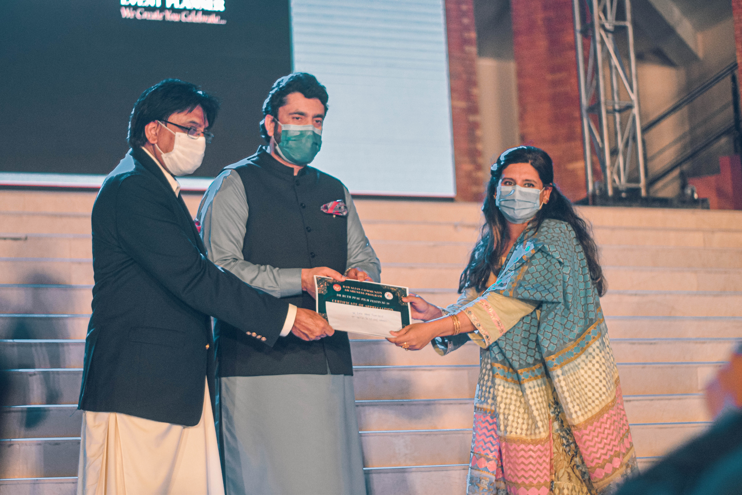
RAWALIAN COMMUNITY AWARENESS PROGRAM
DR RUTH PFAU FILM FESTIVEL
OBJECTIVES
Spread Awareness about COVID 19
Spread Awareness about common health issues prevailing in our society
Sensitize the Public on the need to follow precautionary measures in the wake of COVID 19
Provide students the platform to explore their movie making and acting skills

Slide 33
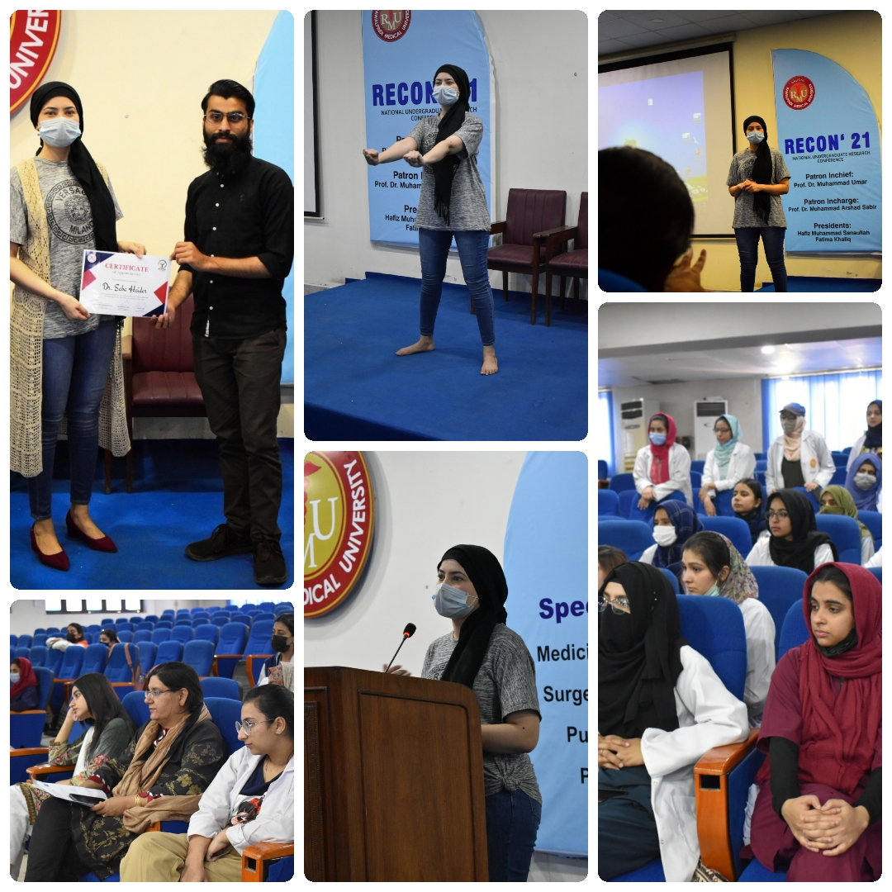
RAWALIAN COMMUNITY AWARENESS PROGRAM
MARKHOUR FITNESS CLUB – MISS FIT
PROJECT DETAILS
Markhor Fitness Club (a project by RCAP) arranged a Nutrition and Fitness workshop in CPC hall NTB RMU, on March 31st, 2022.
Dr. Saba Haider, a renowned nutritionist and fitness expert - the guest speaker of the workshop, gave a very holistic approach for treating health and fitness issues, which encompassed rightful guidance about nutrition and lifestyle.

Slide 34
RAWALIAN COMMUNITY AWARENESS PROGRAM
MARKHOUR FITNESS CLUB – MISS FIT
OBJECTIVES
Fitness for Rawalian girls.
Healthy diet and lifestyle.
Motivate young girls to not only be healthy but be fit.
Address health related issues of young girls.

Slide 35
RAWALIAN COMMUNITY AWARENESS PROGRAM
MARKHOUR FITNESS CLUB – GBPL VS RMU
PROJECT DETAILS
Markhor Fitness Club (a project by RCAP) arranged a Nutrition and Fitness workshop in CPC hall NTB RMU, on March 31st, 2022.
Dr. Saba Haider, a renowned nutritionist and fitness expert - the guest speaker of the workshop, gave a very holistic approach for treating health and fitness issues, which encompassed rightful guidance about nutrition and lifestyle.

Slide 36
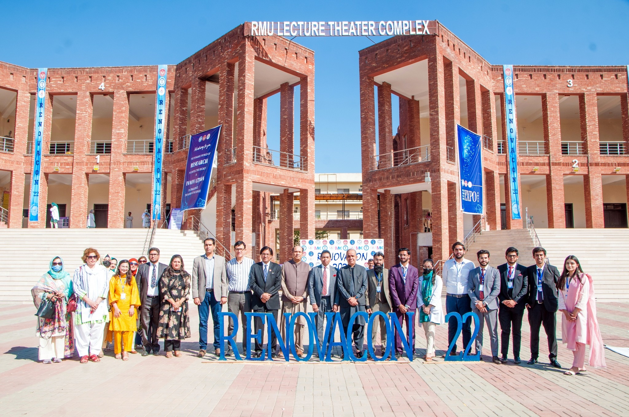
RAWALIAN COMMUNITY AWARENESS PROGRAM
INNOVATION EXPO RENOVACON 22

Slide 37
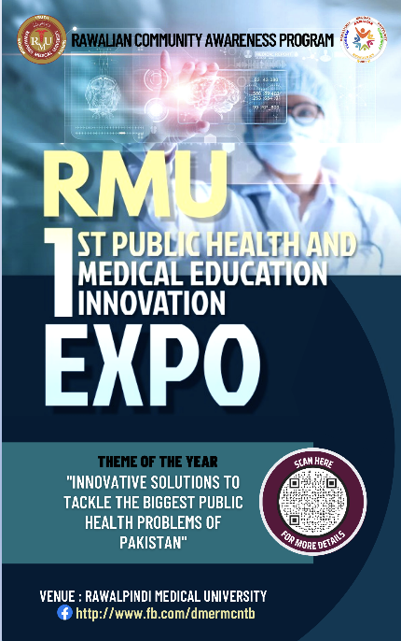
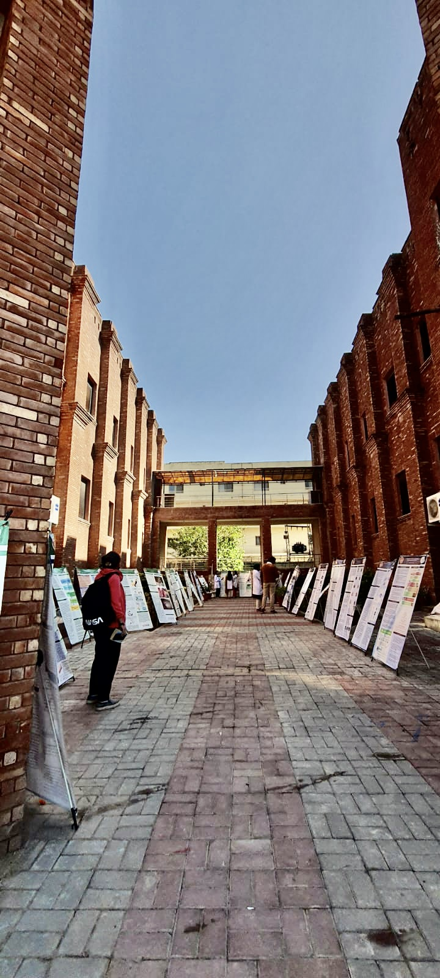
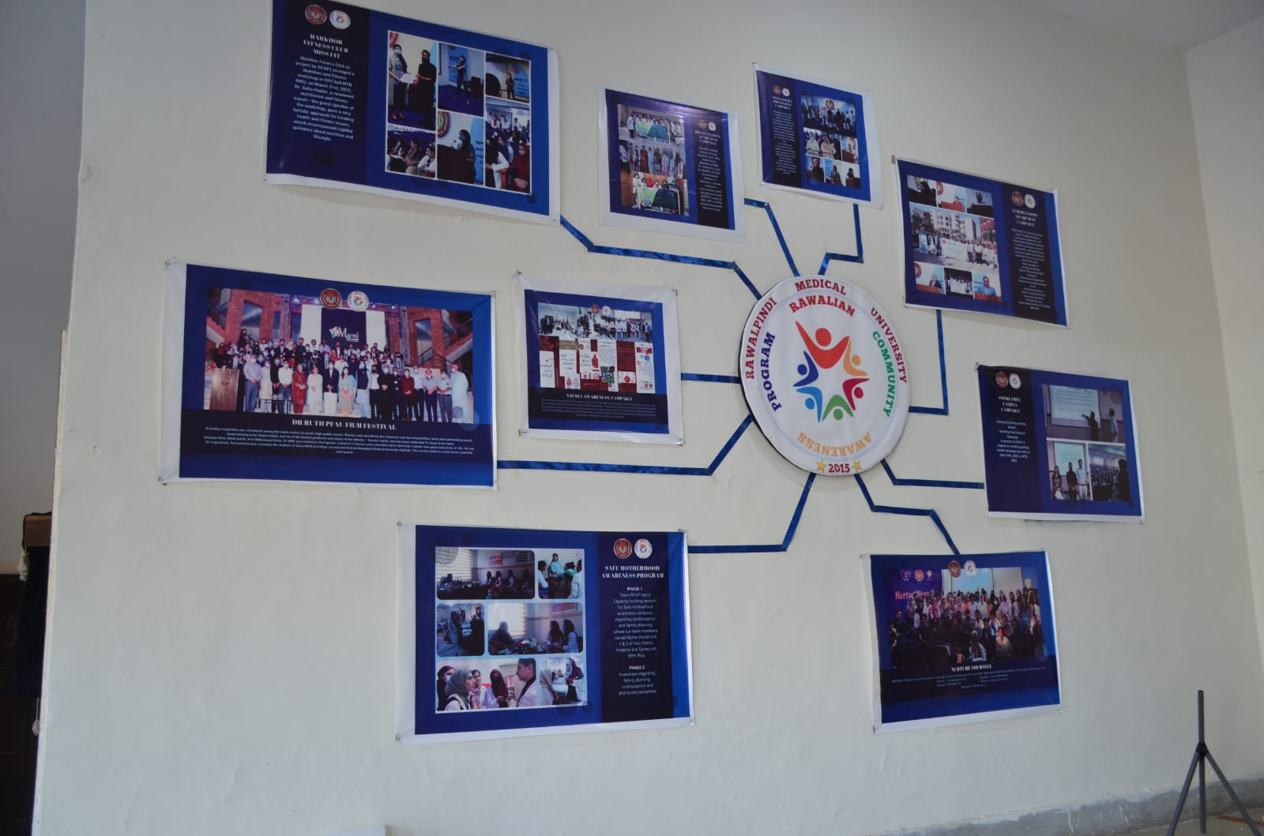
RAWALIAN COMMUNITY AWARENESS PROGRAM
INNOVATION EXPO RENOVACON 22
PROJECT DETAILS
The idea for the innovation expo was built on the fact that healthcare faces intractable challenges, which require innovative solutions. So far, innovation in healthcare is a foreign concept amongst medical students. With this event, we hoped to promote a culture of innovation in our university and foster creativity among its students. Students in RMU were familiarized with the process and event through class sessions, and online webinars were held for medical students from other Universities. Engineering students were also invited to present their healthcare related innovation projects. These efforts garnered the submission of over 100 projects from RMU and various other medical and engineering universities, notably King Edward Medical College, Foundation University Medical College, Islamabad Medical and DENTAL college, Shifa medical college, NUST and Hitech. Projects were further shortlisted by judges for oral and poster presentations in the aforementioned categories.

Slide 38
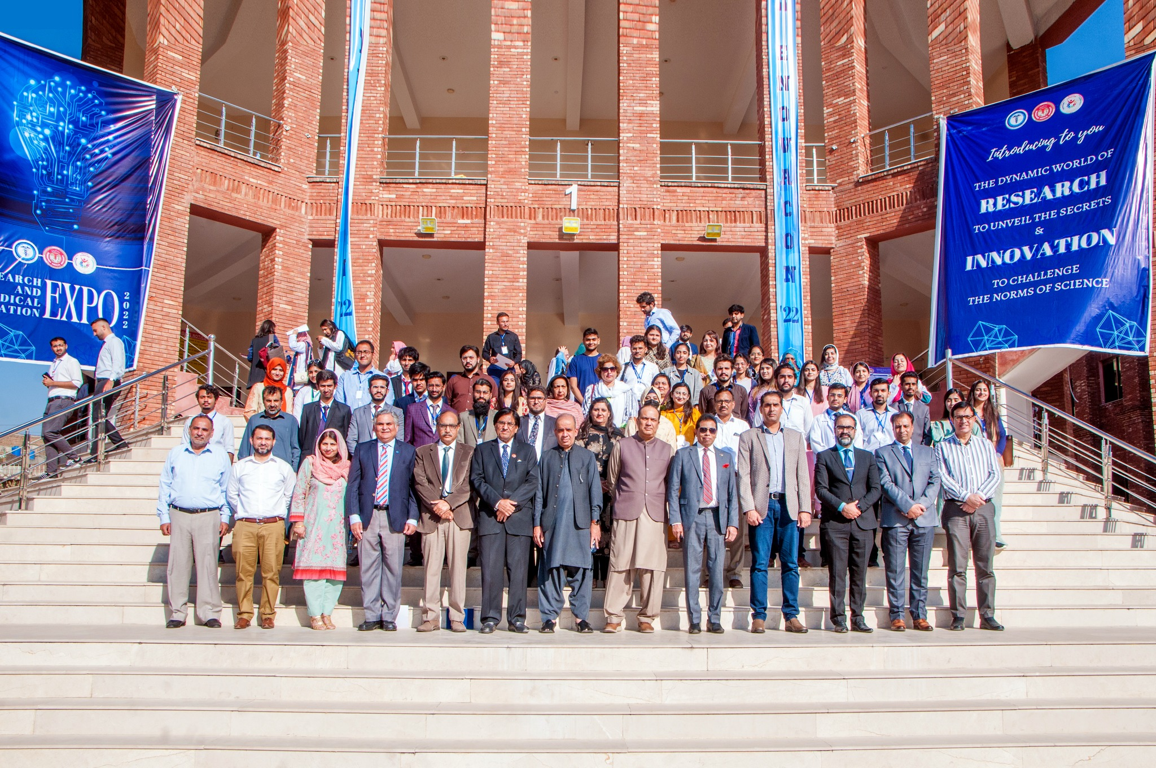
RAWALIAN COMMUNITY AWARENESS PROGRAM
INNOVATION EXPO RENOVACON 22
OBJECTIVES
RCAP is conducting the first ever Innovation Expo as part of RENOVACON’22 in collaboration with Rawalian Student Research Society (RSRS) at Rawalpindi Medical University to promote innovative thinking among medical students and enhance collaboration among the fields of healthcare, engineering, and pharmaceutical sciences. Students from across the region designed and will present over 70 campaigns and innovation projects related to public health, heath technology, and medical education. Our goal is to strive towards a healthier future through health promotion and innovation.

