Slide 1
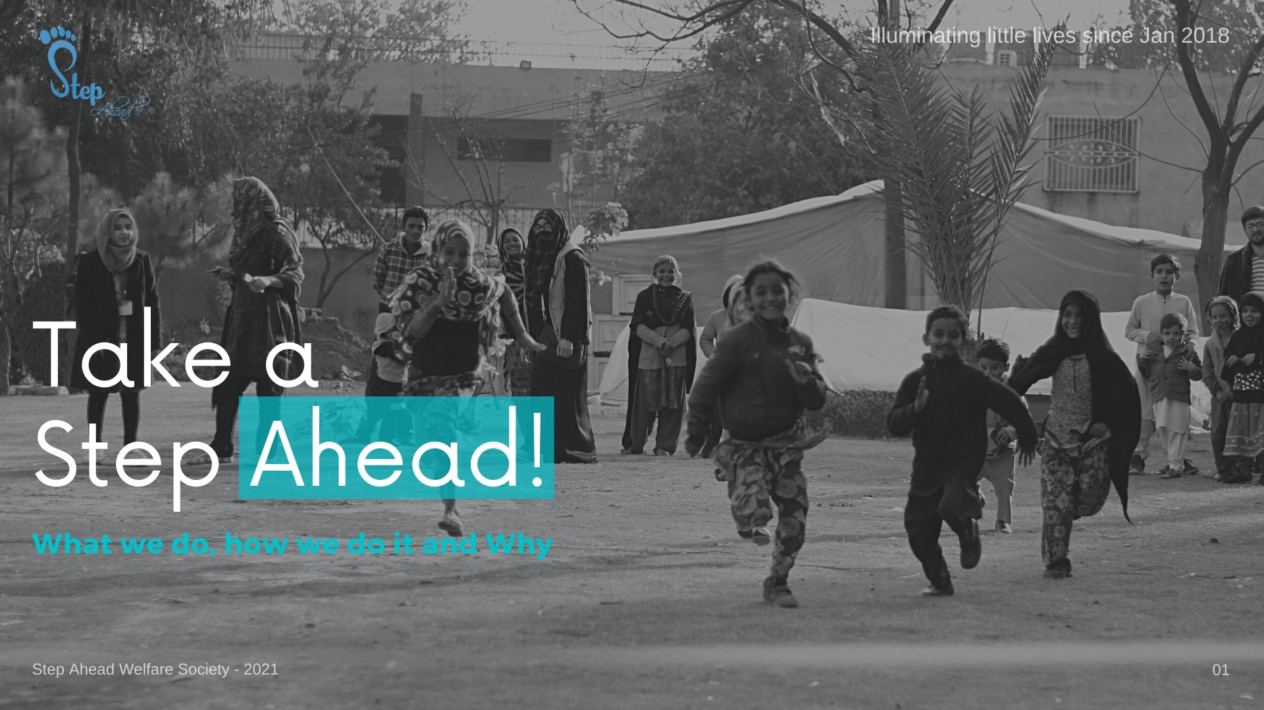



Slide 2
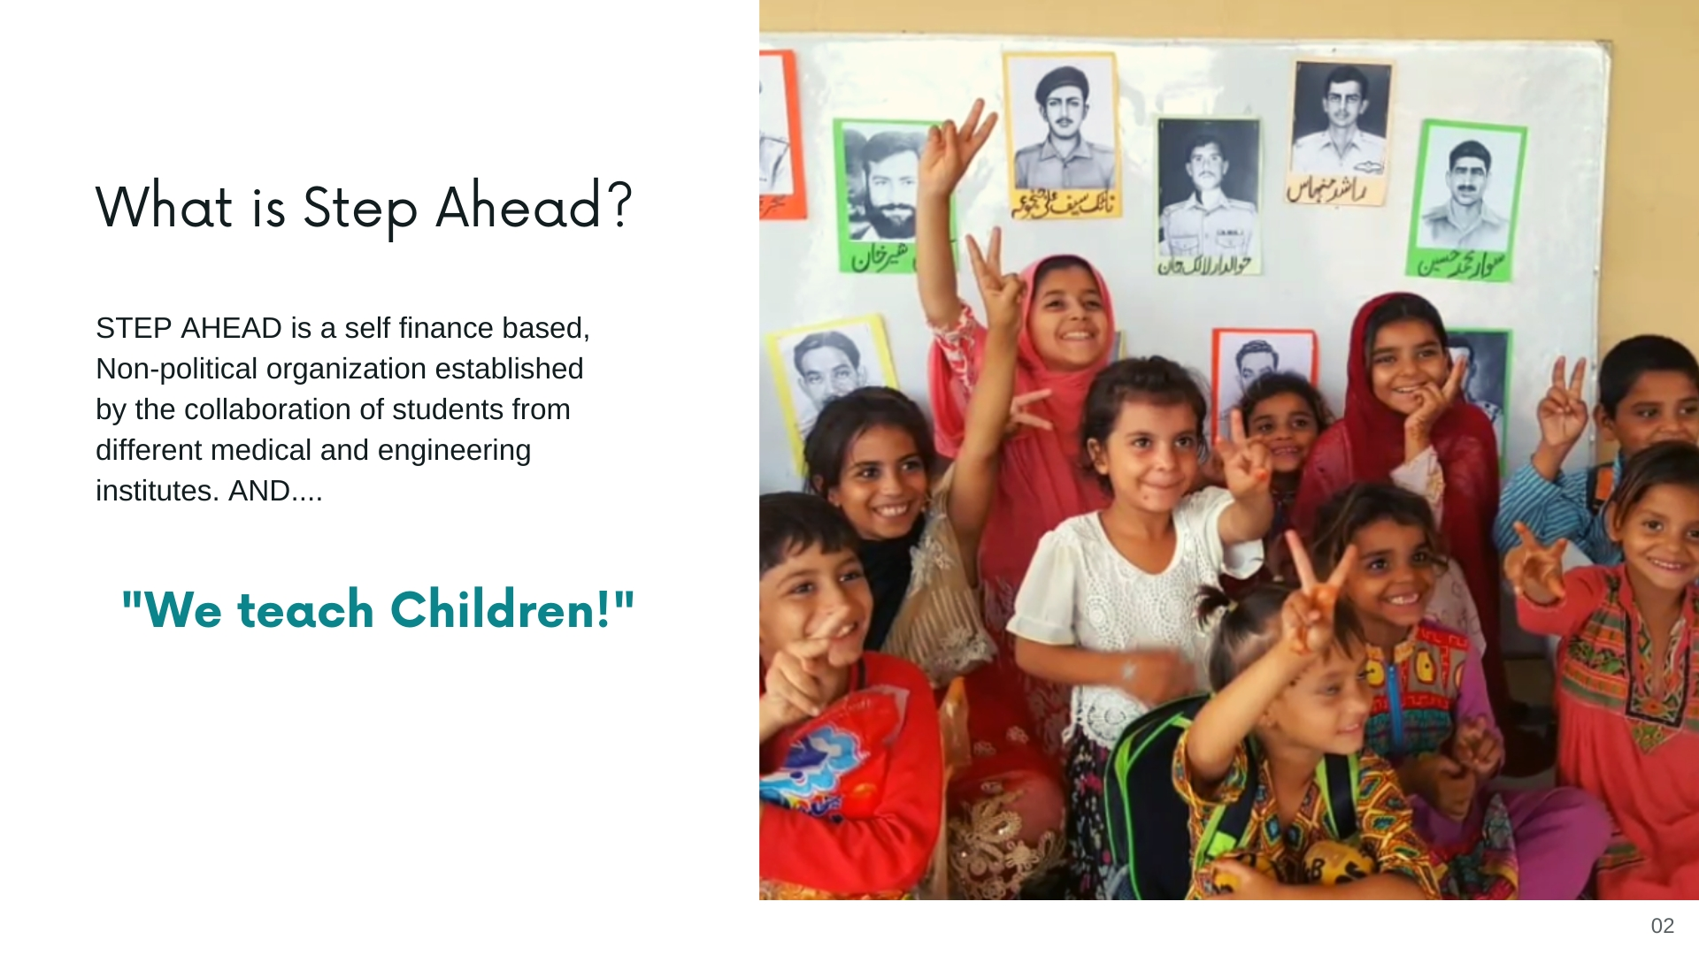
Step Ahead Welfare Society is a self-financed, non-political organization established by students from RMU and run by students of other as well. From the past 5 years (being established in 2018). SAWS has been working to impart education in the kids of slums of Rawalpindi by teaching them 5 days a week at Liaquat bagh,

Slide 3
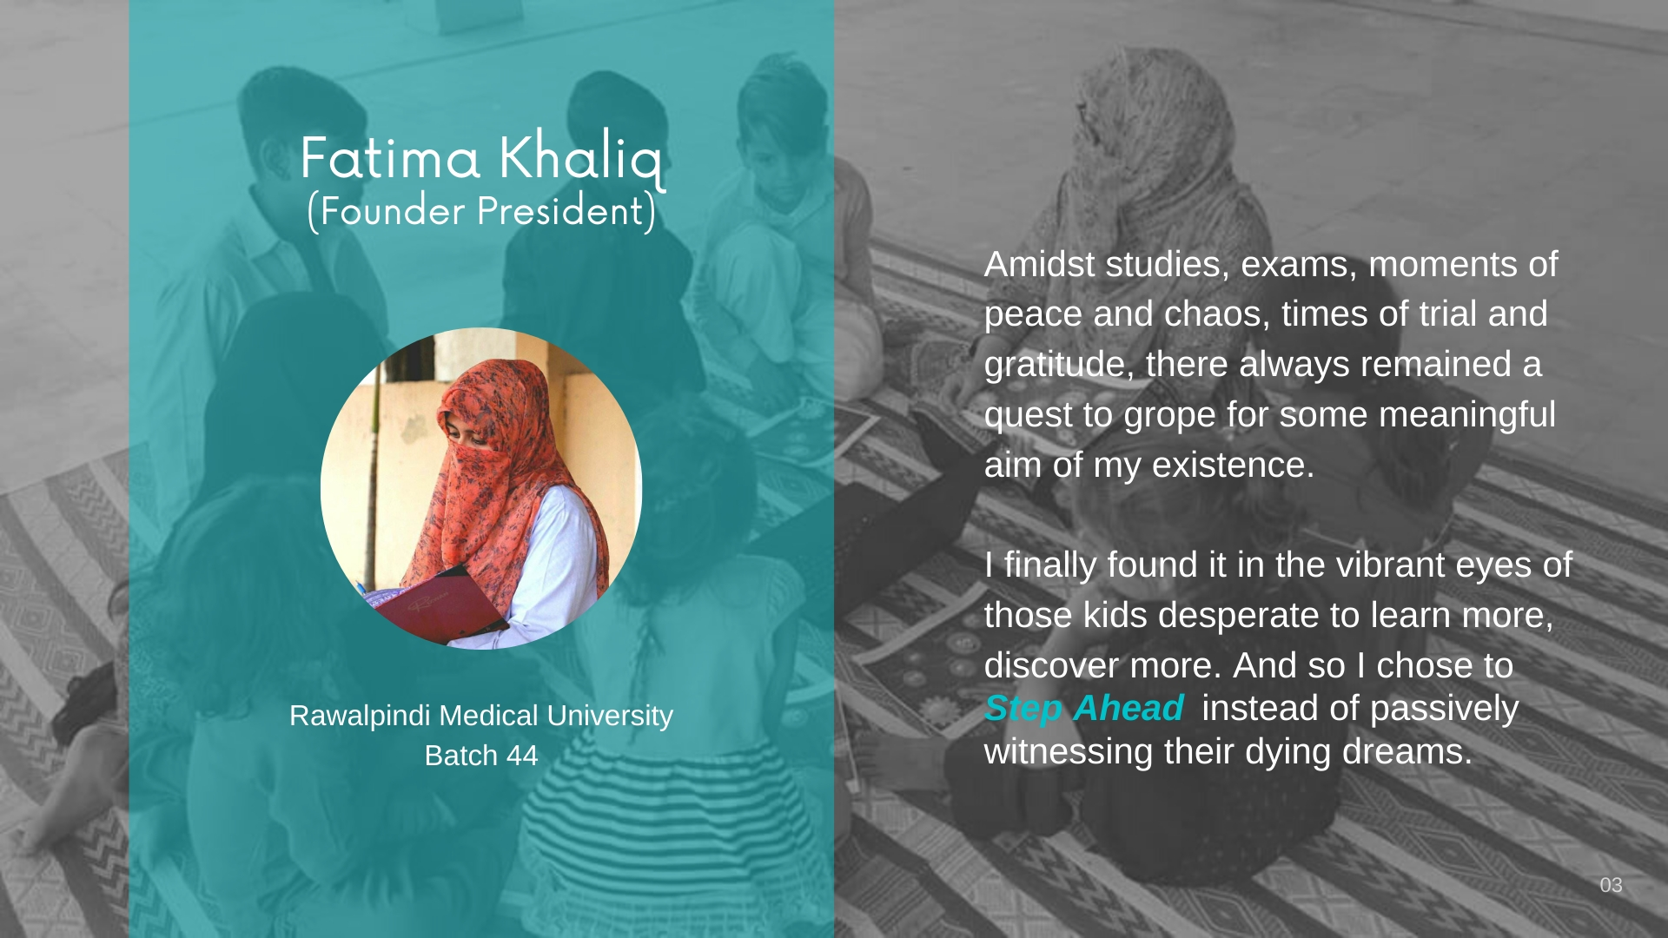

Slide 4
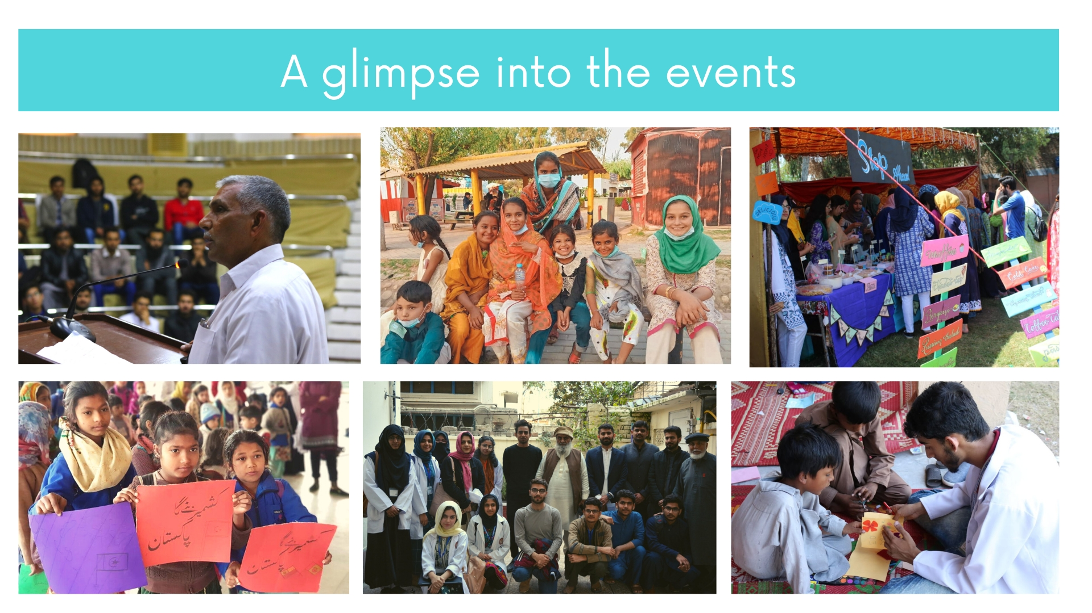
OVERVIEW OF ACTIVITIES
The Society runs a street school in Liaqatbagh 5 days a week throughout the year where 50+ kids from the slums of Mareer Hasan and Arya Mohalla are being taught free of cost. Other than this camp, important activities throughout the year include

Slide 5
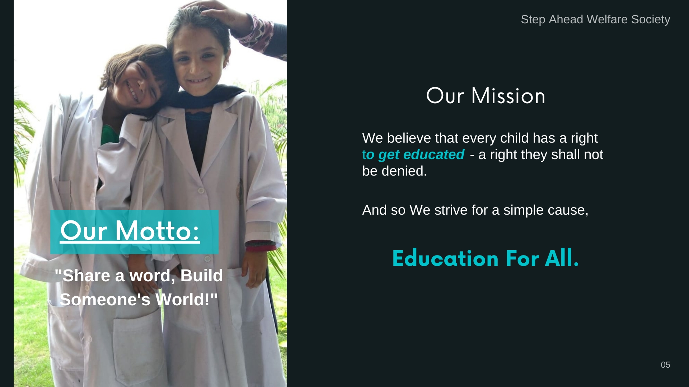

Slide 6
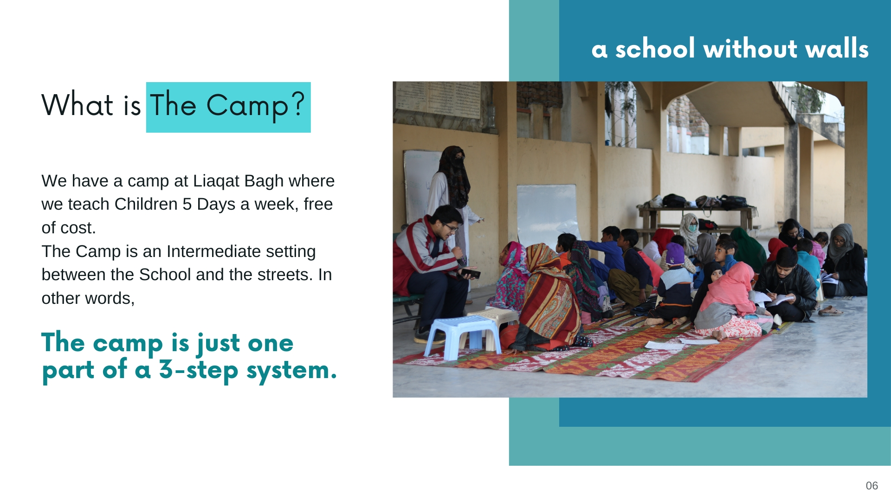

Slide 7
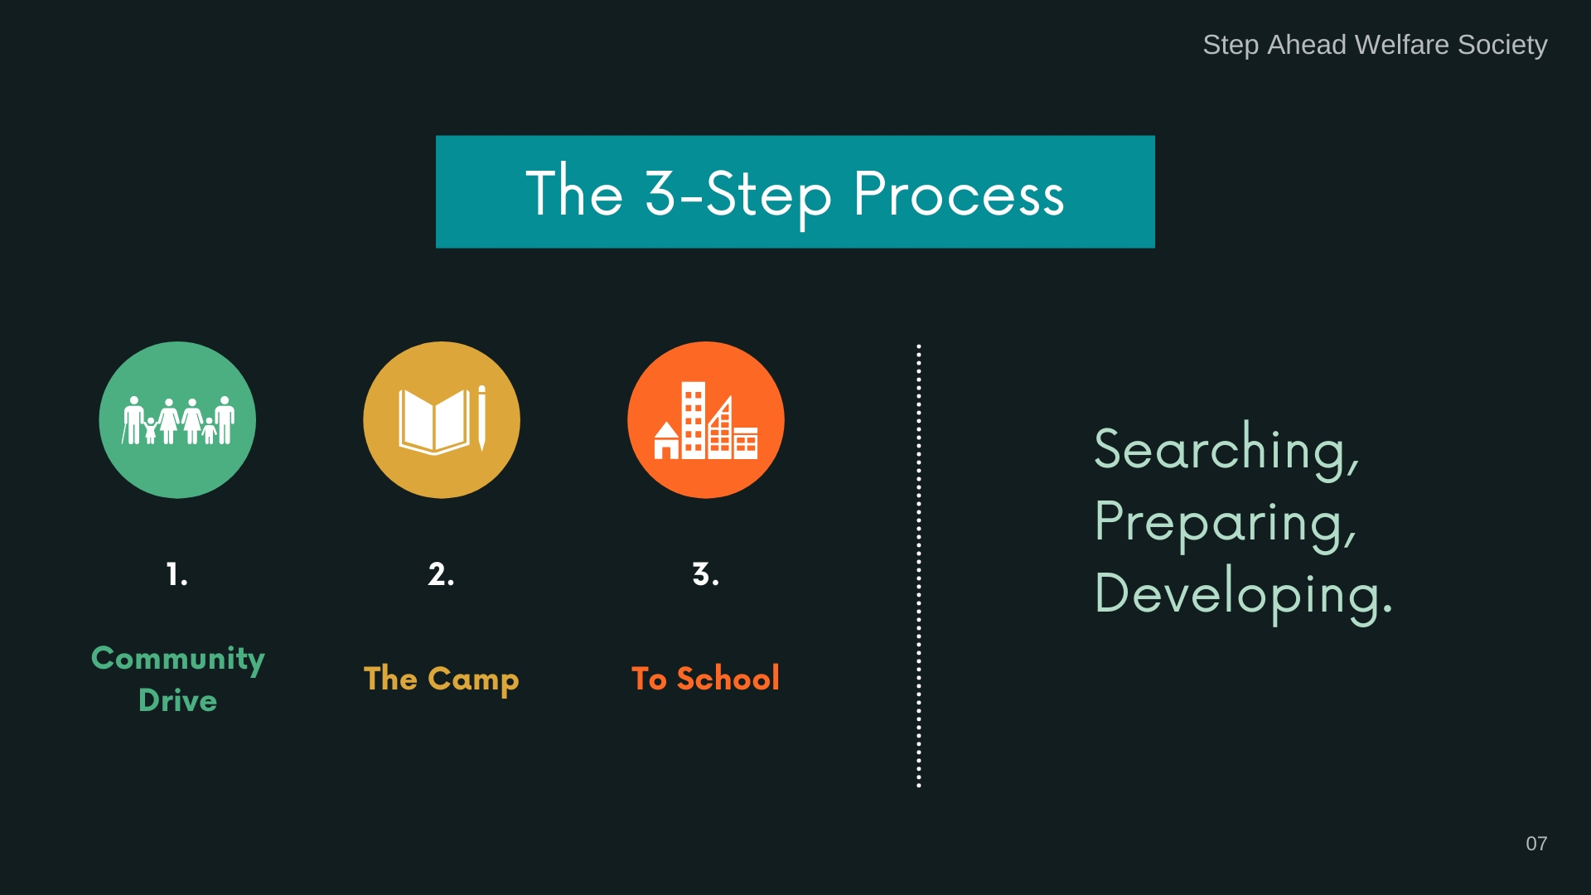

Slide 8
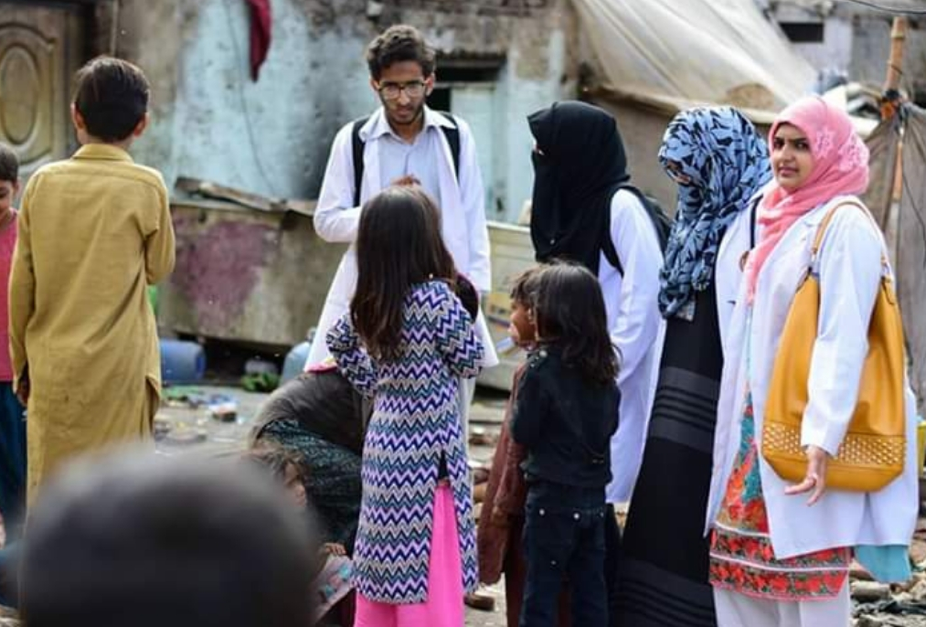
STEP AHEAD WELFARE SOCIETY
RAWALPINDI MEDICAL UNIVERSITY
School admissions
kids are already enrolled in schools and 23 new admissions are in process.
Eid fest 18 - 28th April 2022
Eid fest covering 8 orphanages and 2 old homes of twin cities was arranged where eid gifts and ration was presented. Donations collected for this fest were Rs. 74,390.
Community drives
Community drives are conducted to discuss the problems of kids with their parents and raise awareness about education at Arya Mohalla and Marrir. A total of 4 community drives were conducted dated 27th Aug 2021, 16th Jan 2022 , 26th Aug 2022 and 17th Oct 2022.

Slide 9
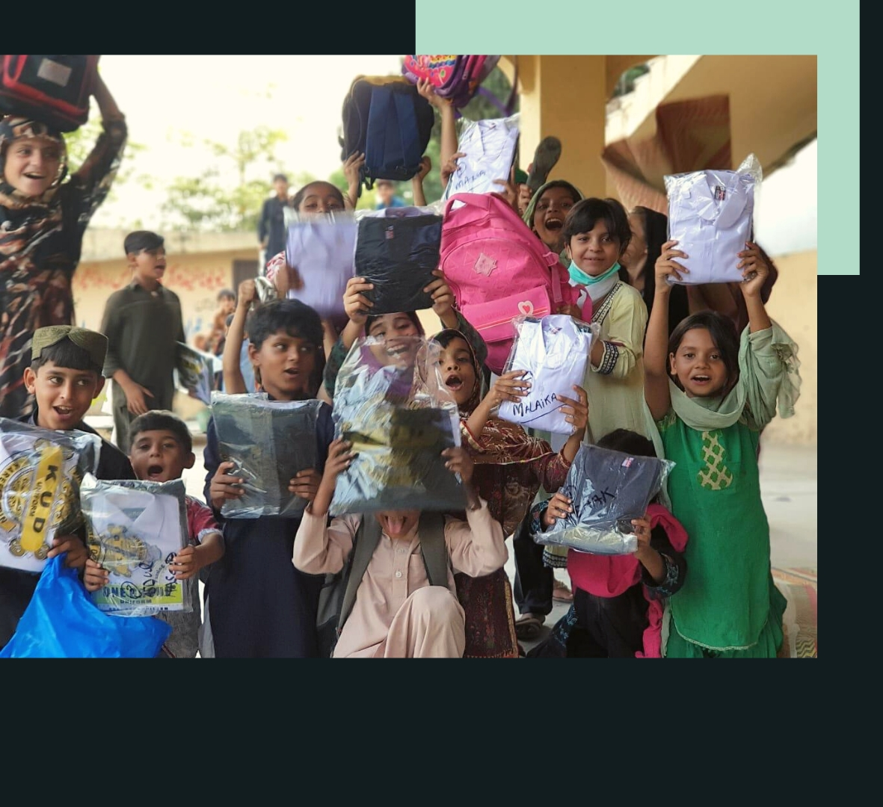
Society fund (from members)
Society fund collected 44,650
Society fund Used 16,313
Society mobile bill 5873 2
Events 10,440
Capital Fund (donations)
Total Donations received 615,285
Total Expenditure 648,269
Fee 463100
Non fee 94369
NUML student Fee 90800

Slide 10
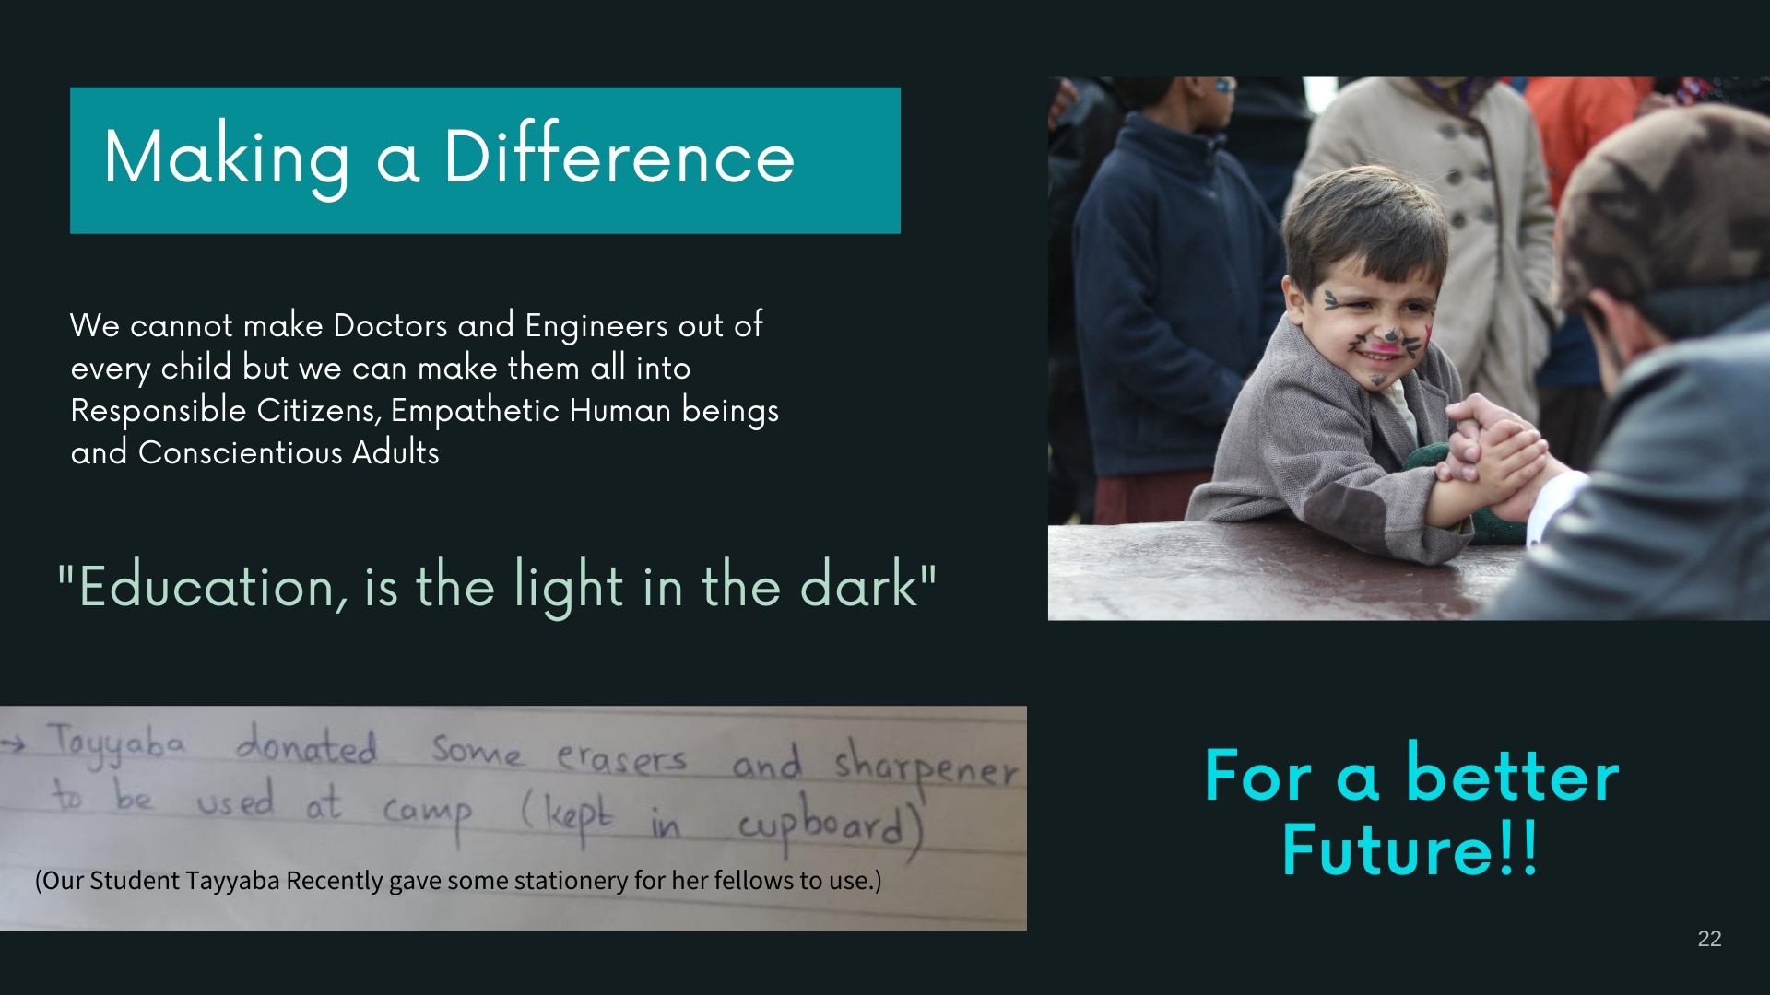
Awareness sessions for kids
Self Defense sessions … a total of 4 sessions from 14th to 21st Oct 2021
Climate change awareness session -6th Nov 2022 (collaborative event with YLCians)
Dengue Awareness session along with sports for the kids 13th Nov 2021 (Collaborative event with OHEC and THP)
Independence day, Eid Milad un Nabi , Iqbals Day celebrations with the intent to familiarize the kids with importance of each event.
Session on Good and Bad Touch 15th Oct 2022 (Collaborative event with TVS)

Slide 11
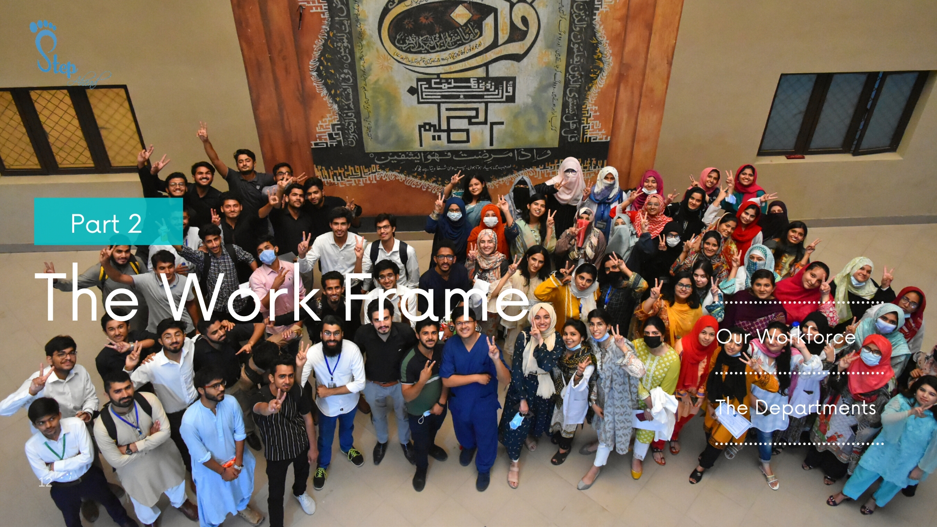

Slide 12
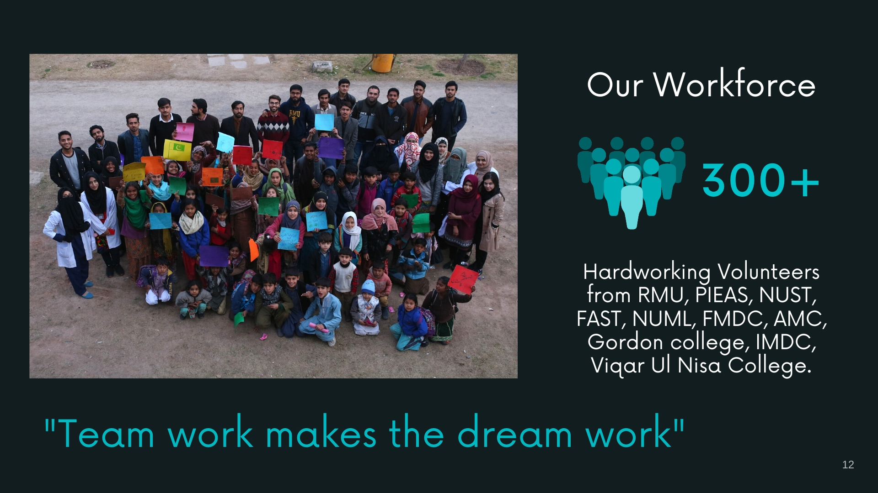

Slide 13
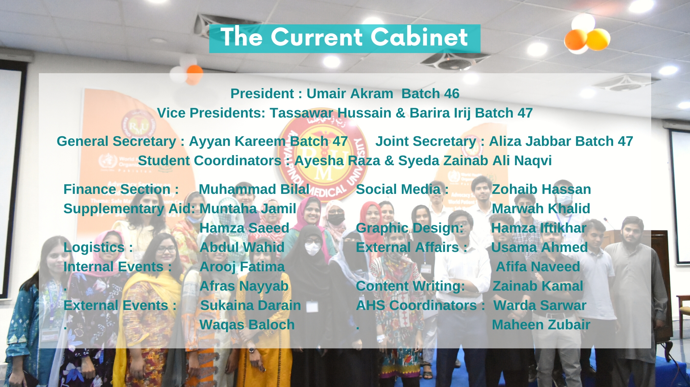

Slide 14
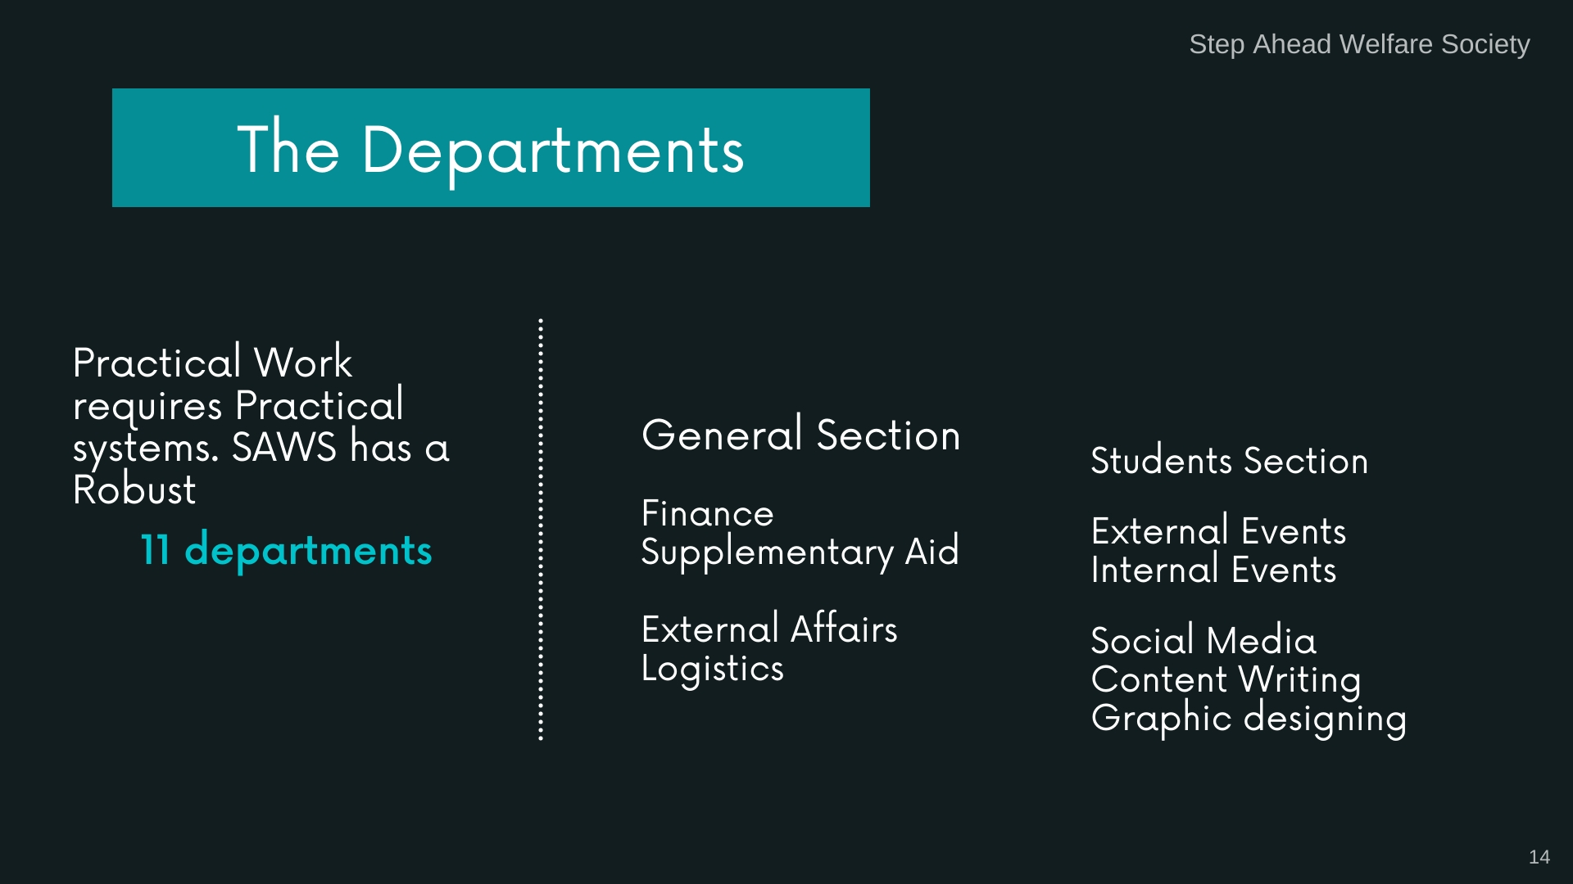

Slide 15
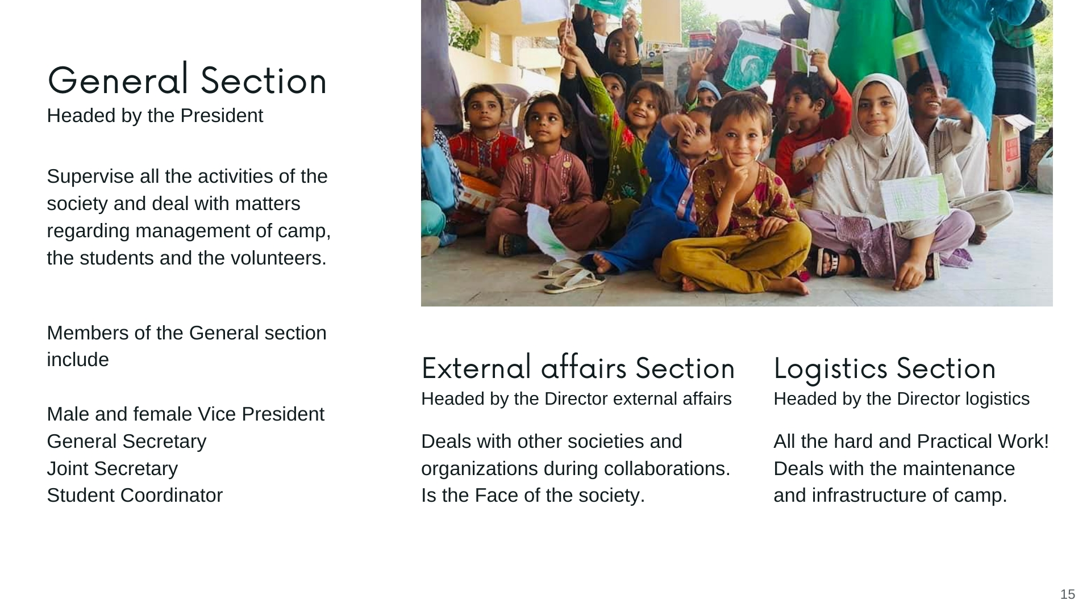
School admissions
kids are already enrolled in schools and 23 new admissions are in process.
Eid fest 18 - 28th April 2022
Eid fest covering 8 orphanages and 2 old homes of twin cities was arranged where eid gifts and ration was presented. Donations collected for this fest were Rs. 74,390.
Community drives
Community drives are conducted to discuss the problems of kids with their parents and raise awareness about education at Arya Mohalla and Marrir. A total of 4 community drives were conducted dated 27th Aug 2021, 16th Jan 2022 , 26th Aug 2022 and 17th Oct 2022.

Slide 16
STEP AHEAD WELFARE SOCIETY
RAWALPINDI MEDICAL UNIVERSITY
Total cases : 10
Total amount: Rs, 307,790
CASE # | UNIVERSITY NAME | AMOUNT GIVEN
Case 21 | Laureate School Al Rasool Campus Multan | Rs 4000/- (From June 2021 to Feb 2022)
Case 22 | St. John’s High school Rawalpindi | Rs. 6400
Case 23 | The Women University Multan | Rs. 13000 (LOAN)
Case 24 | Allama Iqbal Open University | Rs. 1150/-
Case 25 | Riphah International University | Rs. 54000/-
Case 26 | BIMS | Rs 54,000
Case 27 | Faisalabad Medical University | Rs 24,240
Case 28 | International Islamic Medical College | Rs 50,000
Case 29 | UET | Rs20,000
Case 30 | Sargodha Medical College | Rs 49,000

Slide 17
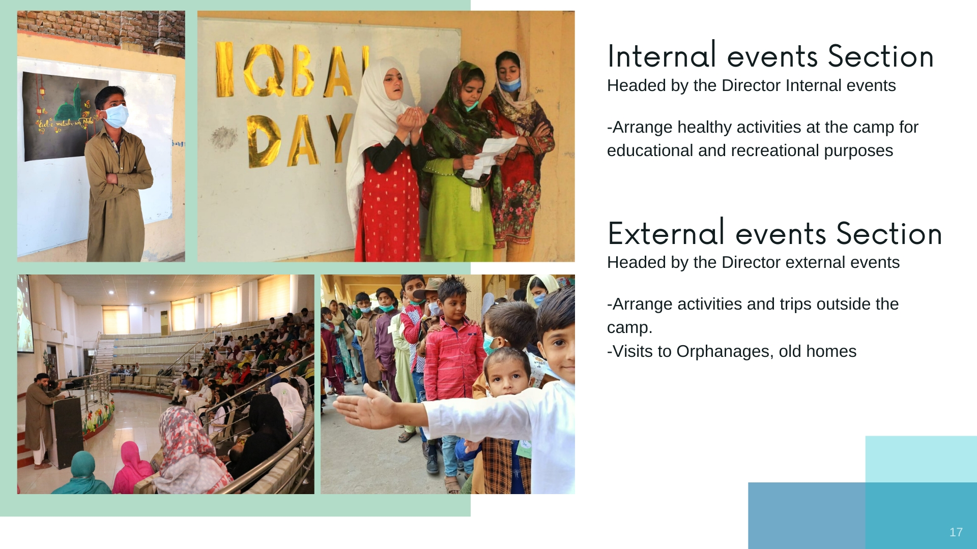

Slide 19
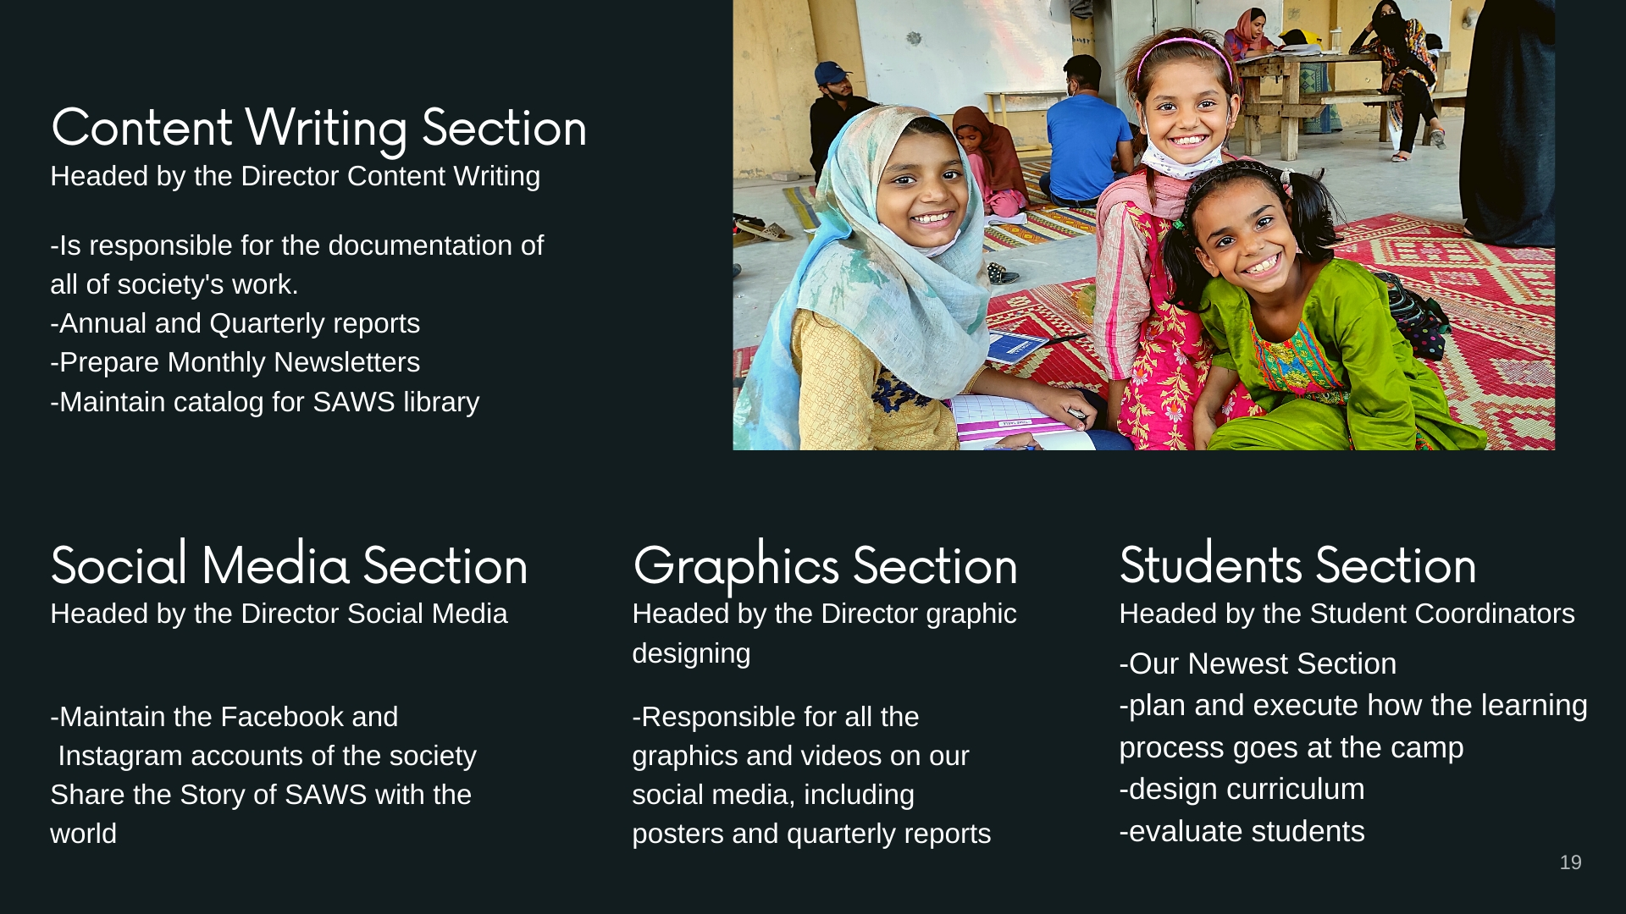

Slide 20
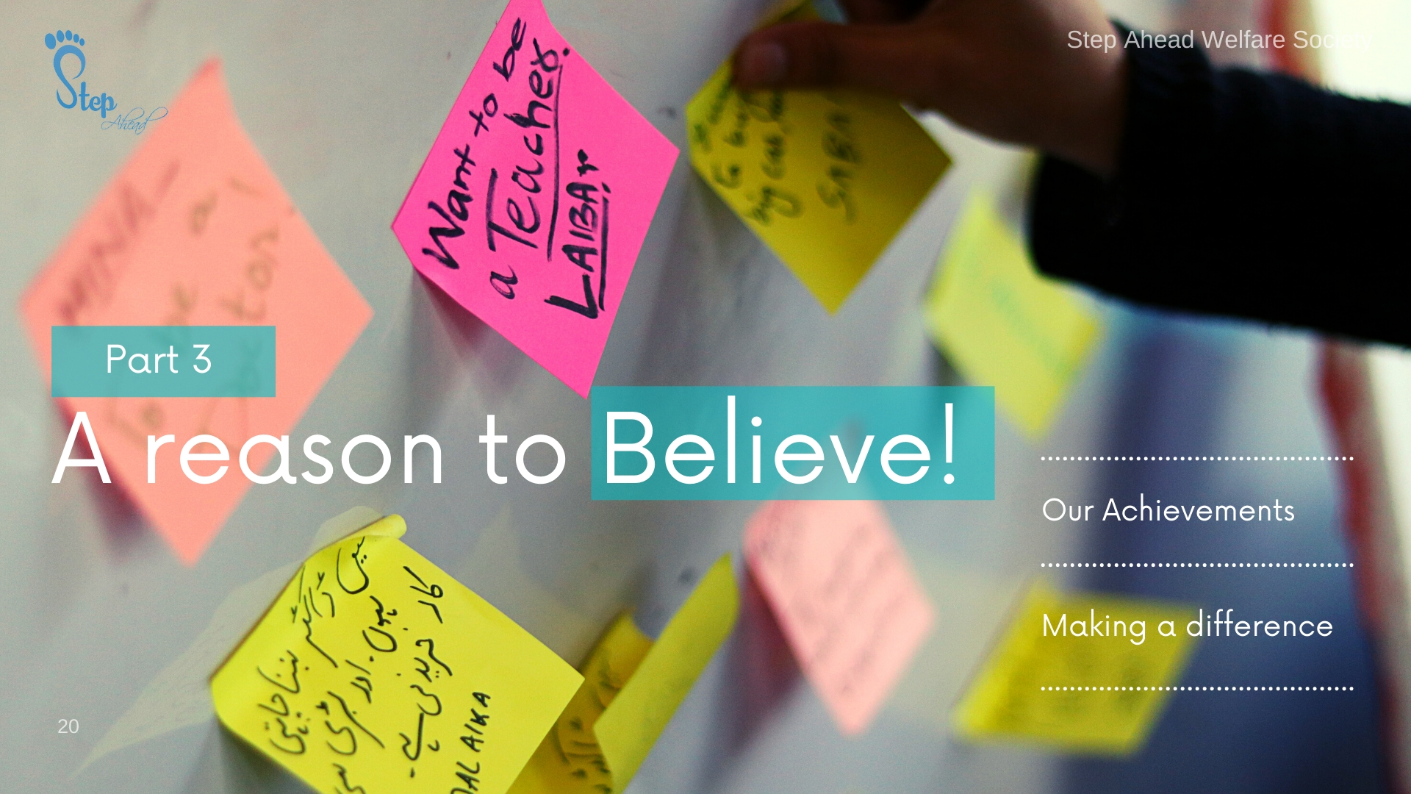

Slide 22
